Slide 1
Music Technology in the Hands of Women
Women, Music, Culture Chapter 15

Slide 2
FOCUS AREAS
Technology has always driven musical change
In the 20th century, electronic technology was used to record, generate, and manipulate sound
The roots of electronic music technology were informed by physics, mathematics, and mechanics, fields traditionally closed to women
Art music and popular music utilized similar electroacoustic techniques

Slide 3
Electricity
From the hum of power plants to the soundtracks of horror films, electronically-produced sound became part of the world’s soundscape in the 20th Century

Slide 4
Innovation
New technology captured the imaginations of musicians who used it not only to record sound, but to generate new sounds

Slide 5
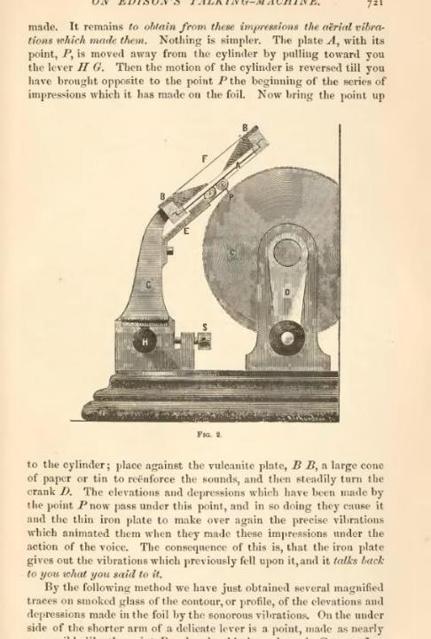
Experimentation
An 1877 Popular Science Monthly article on Edison’s “talking machine” showed readers how sound could be preserved by transferring “aerial vibrations” to a series of impressions on foil

Slide 6
Many early electronic music experiments took place in university laboratories
Mathematician-musicians and engineers worked collaboratively to develop new equipment to experiment with sound
Women who lacked access to university employment were restricted from early experimentation

Slide 7
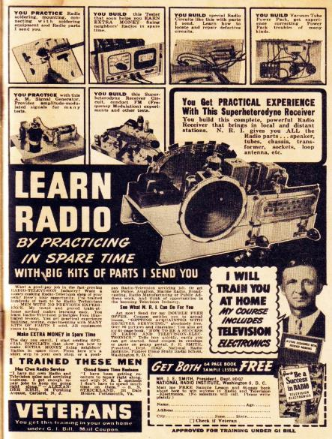
The 20th century amateur technology scene also was geared toward men, as evidenced in this 1949 America’s Best Comics advertisement

Slide 8
Despite the disproportionate number of men involved in electronic music in the 20th century, women played key roles in early electronic music development…
Bebe Barron was a charter member of the Society for Electroacoustic Music in the United States, and recipient of its annual Lifetime Achievement Award in 1997
Alice Shields and Pril Smiley were involved at the Columbia Princeton Electronic Music Center
Pauline Oliveros worked in university settings on the West coast

Slide 9
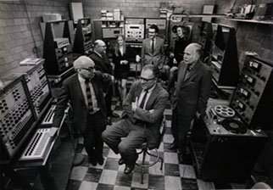
Studio 317, one of four composition studios at the Columbia-Princeton Electronic Music Center, circa 1970. Clockwise from the center front, Vladimir Ussachevsky (seated), Milton Babbitt, Bülent Arel, Pril Smiley, Mario Davidovsky, Alice Shields, Otto Luening. Photo used by permission.

Slide 10
University experimentation quickly impacted popular music. Movie scores and popular music recordings utilized a wide range of emerging technology.

Slide 11
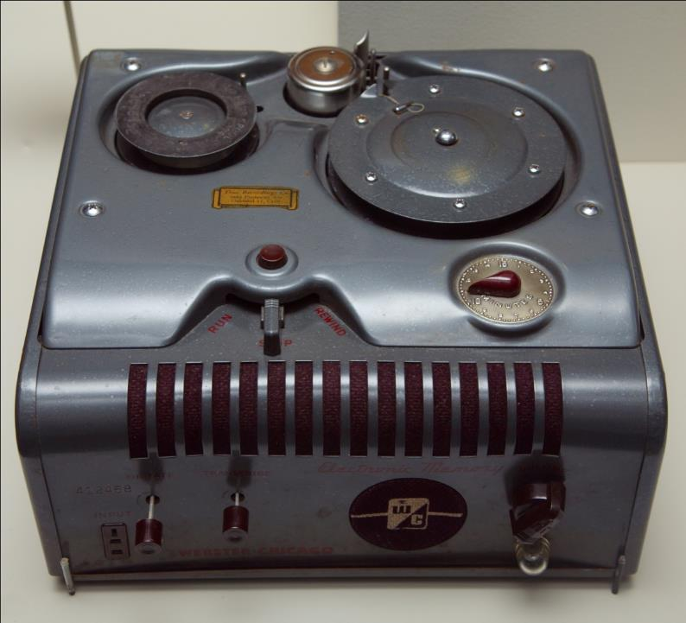
Recording devices such as this 1951 wire recorder allowed for experiments with playback speeds. This technology was used in both art and popular music.

Slide 12
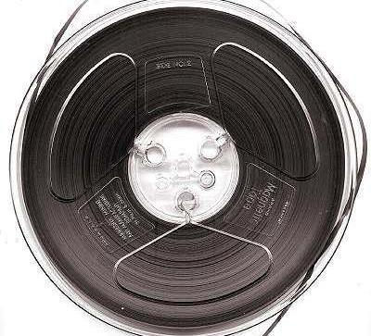
Magnetic tape technology allowed a wide array of sound manipulation. A tape could be cut, rearranged, run in reverse, or played at variable speeds. Shown right, a 7-inch reel of magnetic recording tape, as used in the mid-1960s. Image by Daniel P. B. Smith

Slide 13
Digital Technology
Digital composition involved mathematical analysis of waveform structures and opened a new technological frontier.

Slide 14
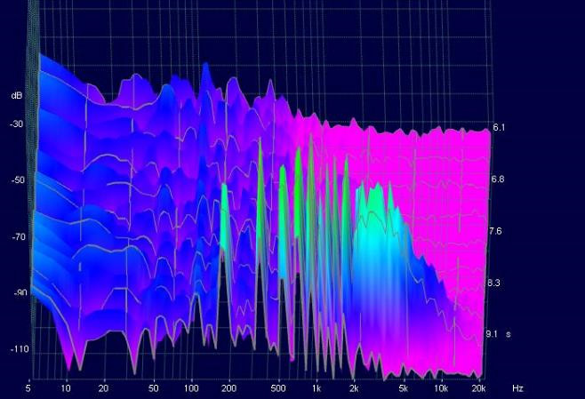
Using spectrum analysis, a computer analysis of waveforms, innovators could electronically reproduce acoustic sounds and could also create new sounds. At right is a spectrum analysis of a vibrating violin string.

Slide 15
Sound Engineering is another music technology field that emerged in the 20th century, and it greatly impacted both art and popular music. Studio engineers alter sound after it has been captured, taking artistic control into their own hands.

Slide 16
Women in sound engineering had difficulty accessing lead engineer positions due to perceptions about women and technology Internships and hands-on experience with equipment is essential, and women had limited access to the informal networking system within the field

Slide 17
Grammy-winning sound engineer Leslie Ann Jones indicates: “It’s difficult for an all-male staff to suddenly work with a woman…Men are used to women acting as caretakers, note takers, studio managers…not as the ones making the technical decisions.”

Slide 18
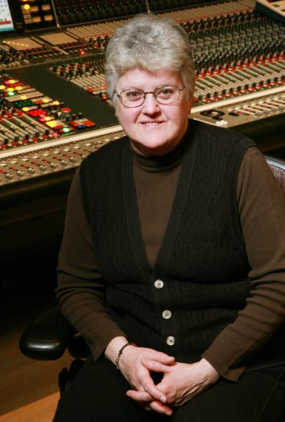
Sound Engineer Leslie Ann Jones. Photo by Steve Jennings, used by permission

Slide 19
In 2020, women accounted for fewer than 5 percent of people employed in music technology.
Data: Women’s Audio Mission, accessed 2020

Slide 20
Women who have been successful in technology venues have often formed their own labels, businesses, and schools.
Women’s Audio Mission is a good example

Slide 21
Women continue to break ground in music technology. From female DJs such as Kuttin Kandi, to sound engineers and art music composers, women in music technology are rising above challenges to become leaders and innovators.

