Slide 1
Women, Music, Culture Chapter 4
Court Performers of Japan, India, and Europe:
Freedom and Restriction

Slide 2
Court Traditions Existed Across Many Cultures
Arts traditions were deeply linked to the courts
Women had important roles as singers, dancers, instrumentalists and composers

Slide 3
The courtesan (court musician)was revered, but was also socially suspect
In an era when most women could not read or write, the courtesan was well educated.
She could converse with men and provide entertainment, however…
She was often considered morally and sexually corrupt

Slide 4
Court singers were often connected with the image of the “siren” – sexually attractive, to the point of endangering men

Slide 5
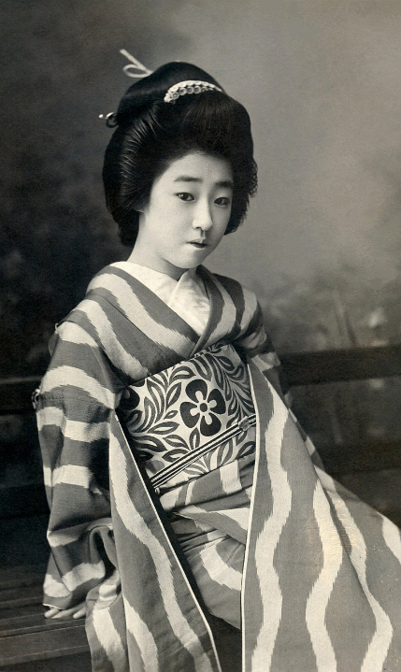
The Geisha of Japan
The “gei-sha” (arts person) composed and performed in public, but eventually was physically restricted to a licensed prostitution district

Slide 6
The Devadasi of India
The Devadasi (from the Sanskrit “deva,” or goddess), was a woman bound in marriage to a Hindu temple deity. While her performance practice was initially associated with spiritual power, her cultural role was eventually reduced to that of prostitute.

Slide 7
Today, the practice continues as a systematic form of prostitution, and some devadasis are children.
Current devadasis often live in villages as “untouchables” in the Indian caste system.

Slide 8
French European Courts: Troubadour and Trobairitz Songs
Male court composers in France between 1170 and 1260 created sung poetry, or “troubadour songs”
Women who composed these works were known as “trobairitz,” and were of the royal class
The frequent subject: “courtly love”

Slide 9
Although many women composed, there is only one surviving published work of a trobairitz…
“A Chantar” by the Countess of Dia

Slide 10
Italian Courts: Another Center of Musical Activity

Slide 11
The Italian Madrigal
Madrigals were secular songs that emerged in Italy
The musical form is related to the poetry used in the work
Many of the texts had sexual undertones that were understood by the people of that time
Most madrigals were initially composed and performed by men

Slide 12
Maddalena Casulana
Casulana composed and published many madrigals, and was a teacher of composition
Her musical settings downplayed sexual text references

Slide 13
Although published women composers were rare during the Renaissance, musically-educated women from the noble class increasingly were hired to sing professionally in the courts

Slide 14
By 1580, Italian courts began to hire professional female vocal ensembles
The Concerto delle Donne in Ferrara, Italy is thought to be the first such ensemble

Slide 15
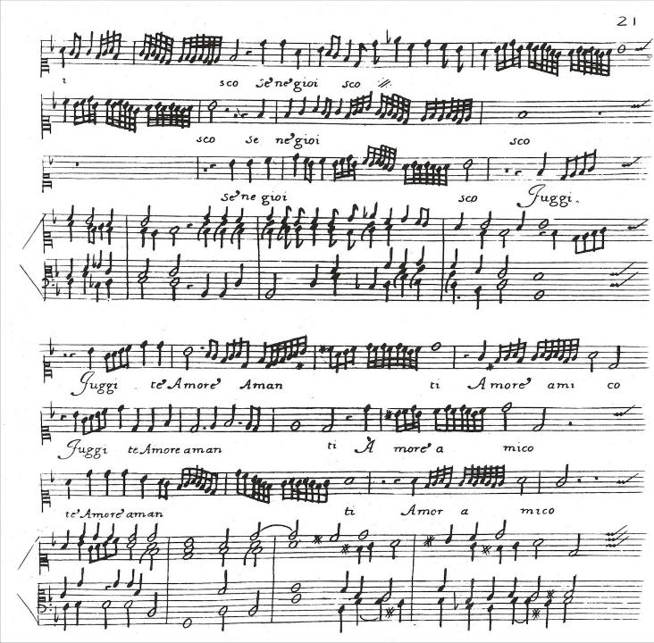
This madrigal excerpt, written for the Ferrara group, represents the musical demands required of professional women’s ensembles. Only trained singers could have executed these passages.

Slide 16
Other courts quickly emulated the Ferrara court and hired their own ensembles
By the dawn of the Baroque era, court-based singing for women was increasingly viewed as socially acceptable

Slide 17
At the same time, the connection between female vocalists and sexuality has been long-standing in many cultures. Does the “courtesan connotation” still remain for women vocalists today?

