Slide 1
Women, Music, Culture Chapter 11
Changing Gender Roles:
From Nineteenth Century Opera to the Modern Musical

Slide 2
Chapter Focus
Portrayals of men and women in staged productions reveal culturally-defined gender expectations
Expected gender roles vary by time and culture
The stage is a place that not only reflects gender expectations, but also challenges them
The stage sometimes allowed performers to say “what could not be said” due to cultural restrictions
This chapter traces opera’s roots, examines sexism in some 19th century operas, and traces changing gender portrayals in Broadway musicals
stereotypical gender portrayals and groundbreaking new depictions of men and women on stage are addressed

Slide 3
Operas and musicals: cultural messages
Audiences are not only entertained by operas and musicals; they also absorb cultural messages contained in the plots and the staging
Presented with powerful music, scenery, and special effects, staged musical productions sometimes mask terrible treatment of women as subjects
The gender lens focuses on men as well as women

Slide 4
more than one feminist lens is used in the chapter. Note how various critics respond to gender portrayals on stage. For example:
On the Critical Side of 19th Century Opera…
Some Feminists Saw Empowerment for Women
Typecasting for women portrayed “female” characteristics as virtuous, and others as “villainous”
Meekness and passivity were considered “ideal”
Women on stage were often portrayed as mentally and physically weak
Female characters were captured, raped, and murdered to the tune of beautiful music
3rd wave feminists argued that the power of a prima donna’s voice on stage prevailed in spite of any storyline
These critics see the music itself as a form of narrative, projecting meaning, attitude, and intention
In this sense, operatic women are not passive or silent at all

Slide 5
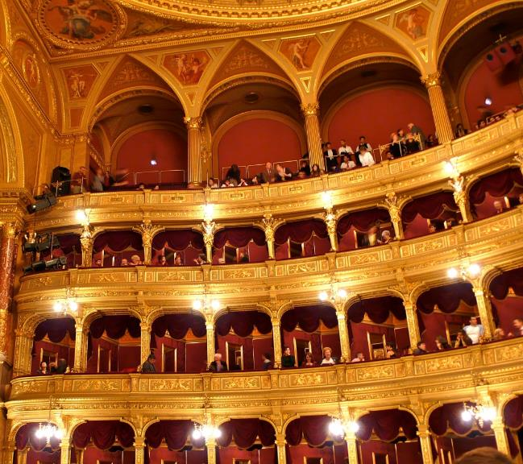
Opera’s roots : initially an invitation-only art for the wealthy

Slide 6
Opera emerged just after 1600, in the Baroque era
Roles for women in Baroque opera were limited

Slide 7
The Castrato in baroque opera
Voice type was more important than the sex of the performer
Treble-range male voices (castrati) were preferred for lead roles
The high-pitched powerful male soprano was cast in the role of “hero” during this era

Slide 8
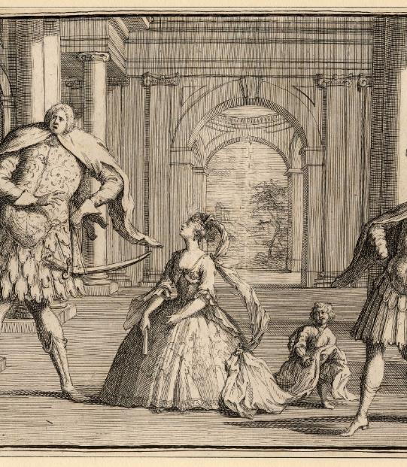
here, An eighteenth century caricature of Handel’s opera Flavio shows over-exaggerated castrato Francesco Bernardi (far left) . Public Domain

Slide 9
Opera reflected changing cultural perceptions of how men and women differ
The “Galenic” Model: One Sex
Sex as a Dichotomy
Posited that there is essentially one sex, and that women were inferior versions of men
This view was consistent with castrati on stage; they could be used as a “blank canvas” to project any sexual role
posited that men and women were opposites
Addressed physical as well as mental and moral characteristics
Women were considered intellectually inferior, but were also feared as temptresses
This view impacted typecasting in 19th century opera

Slide 10
The “danger” of opera, and changing gender depictions
Some societies reacted negatively to depictions of high-pitched, emotional men on stage, and warned of the weakening of society
Others took issue with the use of castrati
19th century opera began to reflect new cultural beliefs about roles for men and women

Slide 11
19th century “gendered” roles
Soprano: high female voice
Portrayed as desirable, meek, passive, weak, morally “good”
Alto: lower female voice
Portrayed as evil, old, a vixen, clever
A common sub-plot was to cast the female leads as moral opposites
Tenor: high male voice
Portrayed as the hero, and love interest of the soprano
Bass: low male voice
Portrayed as evil, dumb

Slide 12
A wider audience
In the 19th century, opera’s audience expanded. Those who could afford tickets could attend
Operatic music was often the popular music of its time. Arias were known and sung by the public, like pop tunes
Middle-class audience members still like to play the role of the wealthy by attending opera, with elaborate dress and spectacle

Slide 13
19th century: Peak popularity, peak sexism?
Some of the most revered and popular operas are considered the most sexist
Women characters are subjected to rape, death, suffering, and weakness
Female characters also frequently go insane, commit suicide, or become hysterical

Slide 14
In Puccini’s Madama Butterfly, the lead character commits suicide to the tune of one of opera’s most beloved arias. It is one of the most performed operas today.

Slide 15
An alternative view of the 19th century
Some third-wave feminists argue that 19th century opera allowed women in the audience to live vicariously through characters on stage
Voicing stories that society silenced, real experiences and prejudices experienced by women in the audience could be examined by connecting with women on stage

Slide 16
20th century decline of opera
Opera’s popularity peaked in the 19th century
Even today, 19th century operas (along with 18th century Mozart operas) are the most popular and the most performed

Slide 17
Broadway musicals
Musicals, unlike opera, still draw large, live audiences
Broadway’s most avid fans are women

Slide 18
Broadway expands its influence into the public consciousness with music performed at talent shows, on television, and in karaoke settings.
Some of the most popular musicals are also made into “musical movies”

Slide 19
Gender reflections
Like opera, musicals tend to reflect culturally-defined gender roles
The strengthening of women in Broadway musicals is not linear. There were strong roles in the 1940s and 1950s, and weak roles later. Overall, though, much has changed since 1950.

Slide 20
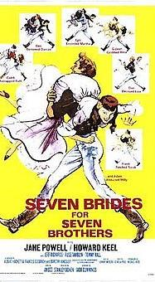
Depictions of women in Seven brides for seven brothers (1954) are notably different from the strong characters found in Wicked (2003) Wicked Photo Credit: Joan Marcus

Slide 21
New shows, new roles
Over time, newer shows brought a different perspective on race and gender to Broadway. Examples include Rent and Wicked, among others
In Wicked, for example, two female characters are the central focus on the show, and audiences see strong female leads

Slide 22
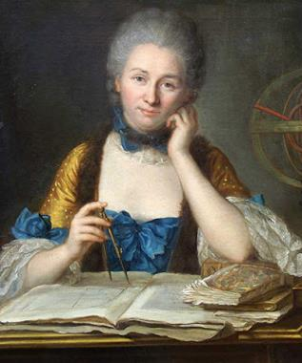
Some operas also showcased new, powerful roles for women, such kaija saariaho’s Emilie, about French philosopher, mathematician and physicist Emilie du Chatelet. Unfortunately, these shows often do not do well financially.

Slide 23
The 1980s: a sexist throwback?
Megamusicals of the 1980s like Phantom of the Opera, Miss Saigon, and Les Misérables were based on 19th century stories, and retell sexist narratives
Miss Saigon is a re-working of Madama Butterfly, for example

Slide 24
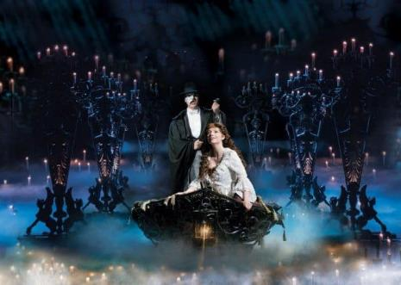
These shows are still the top box office performers in the world of musicals

Slide 25
summary
Operas and musicals reflect cultural issues of their time
Societal beliefs about gender are evident in characterization and plots
Operas and musicals send their messages in dramatic ways
Sometimes music and scenery can “mask” story lines that audiences would normally find offensive
These art forms also challenge audiences to think in new ways, and can have a role in shaping new beliefs

