Slide 1
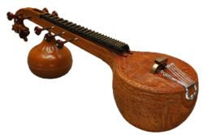
Women, Music, Culture Chapter Three
Women in World Music: An Expanded View of Global Narratives

Slide 2
Defining “World Music” Can Be Difficult
Initially referenced the academic field of ethnomusicology
Expanded to include popular and traditional styles
Also became a recording-industry label

Slide 3
Ethnomusicology is the study of music in cultural context
Embraces private-sphere study
Embraces the study of music in everyday life
Should be open to investigating musical work of women

Slide 4
In reality, women are significantly under-represented in academic materials Instruments are usually shown in the hands of male performers

Slide 5
Turn-of-the 21st century textbooks revealed bias. Analysis of 465 in-Text Photographs from 1990-2010

Slide 6
In 2020, one established textbook featured 365 tracks on its playlist, of which only 21 featured women

Slide 7
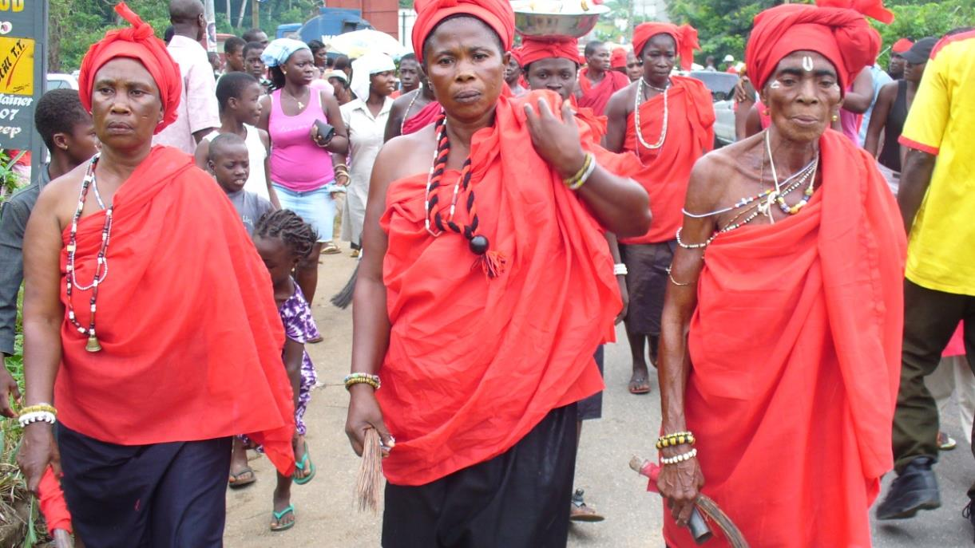
Women’s ensembles and ceremonies often remain ignored.
Photo by permission of Kwesi Brown

Slide 8
Initial research and reporting focused on music performed by men
Public-sphere rituals were favored
Representative examples: West African drumming rituals and Indonesian gamelan performances with a focus on male roles

Slide 9
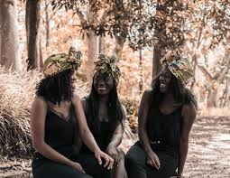
Even now:
There is a tendency to negate information supplied by women
Once “tradition” is established, curricular change is slow

Slide 10
Today, ethnomusicologists study a wide variety of global music that includes life-cycle rituals, spiritual rituals, folk music, art music, and popular music
This chapter investigates women’s roles in all of these traditions

Slide 11
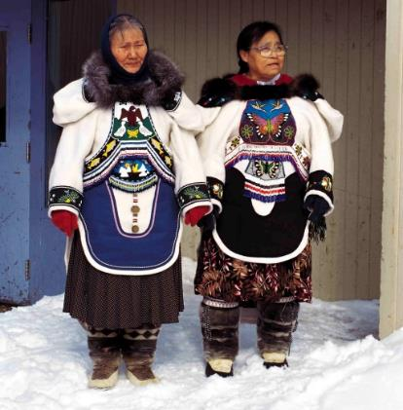
Music of Everyday Life: Inuit Throat Singing
Most global throat singing traditions that are highlighted in world music narratives are performed by men.
The Inuit throat singing tradition is performed by two women in the form of a contest

Slide 12
In performing this tradition, Inuit women are performing culturally significant work:
They imitate the sounds of the Arctic world in throat-singing
They are also promoting and preserving Inuit culture by sharing tradition multi-generationally

Slide 13
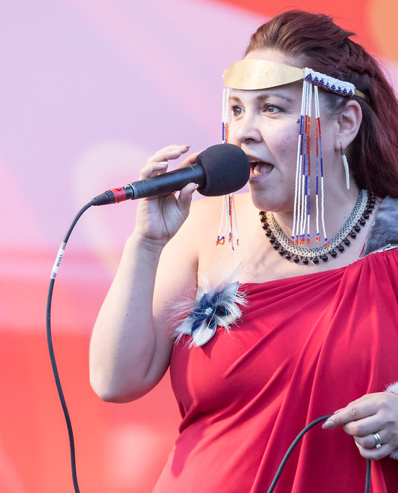
Like many traditional musics, Inuit throat singing has been adapted by some performers
Tanya Tagaq’s commercialized, solo throat-singing format combines traditional sounds with electronic and acoustic instrumentals

Slide 14
Global Children’s Songs and Games: A Reflection of Cultural Beliefs Regarding Gender
Seemingly insignificant playground chants and rhymes are loaded with cultural meaning
In Mexico, for example, children’s games reflect important differences between ethnic groups
Beatriz Aguilar’s collection of authentic children’s songs are good examples of how cultural gender beliefs differ

Slide 15
Day of the Dead and the Catrina
The skeleton dressed as a woman is associated with death in the traditional “Day of the Dead” celebration
Cultural outsiders may view this as a negative connotation

Slide 16
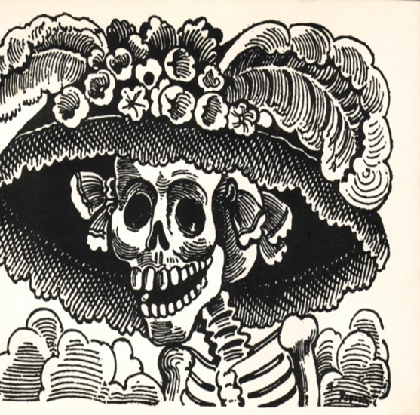
The Catrina
However, many Mexicans link the Catrina to the powerful Aztec goddess Mictecacihuati, who rules the world of the afterlife

Slide 17
Outsider Assumptions and Insider Revelations: “West African Drumming”
Cultural outsiders sometimes view the role of women in the traditional Ghanaian fetish ceremony as subservient to the male role of drumming
Cultural insiders perceive the woman’s role as singer and dancer to be most important, but this aspect of the ceremony is often missing from “world music” narratives

Slide 18
Focus on Soloists
World music narratives initially focused on music making by groups
Eventually, narratives of global stars began to emerge…

Slide 19
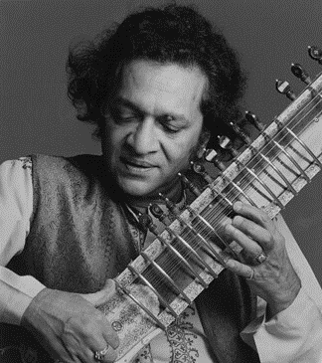
Art Music Virtuosos
Almost every world music text includes a segment on Indian sitar superstar Ravi Shankar

Slide 20
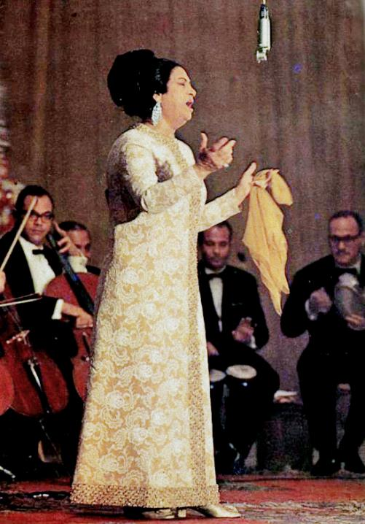
Art Music Virtuosos
Fewer texts feature segments on famous performers like Umm Kulthum, “the voice of Egypt”

Slide 21
World music texts also began to include folk and popular music, but still featured male performers.
There are many female superstars who could be included:
Celia Cruz, “the queen of salsa” is one of the world’s best known Latin artists
Miriam Makeba, known as “Mama Africa,” used the stage to entertain, but also to educate audiences about African traditions

Slide 22
Mercedes Sosa was known as “the voice of the voiceless” in Argentina, and used music to promote social justice
Angelique Kidjo is one of the world’s best known pop stars, but many Americans have not heard her recordings

Slide 23
Women Still Breaking Barriers: Instrumental Music
As much as there is to celebrate in terms of women’s roles in global music, there are areas where women remain restricted due to cultural beliefs
Instrumental music is frequently male-dominated in traditional music, and women are sometimes banned from participation
Chapters twelve and fourteen highlight women instrumentalists in more detail.

Slide 24
Summary
Music is not a universal language in terms of how it is understood from culture to culture
All cultures, however, reflect and construct gender relationships through music
The immense diversity of women’s involvement in global music holds great promise in terms of revealing deeper intercultural understanding
As the field of ethnomusicology continues to develop, researchers would do well to include more narratives that reflect the richness that exists in women’s musical activity

