Slide 1
Women, Music, Culture
Chapter 14
Instrumental to Jazz:
The Forgotten Role of Women

Slide 2

Chapter Focus
Jazz historiography tends to focus on single “superstars” designated to represent specialty areas
This chapter recognizes women who have been highlighted in this manner, but also introduces less-adulated populations

Slide 3
Roots of Jazz
Jazz history narratives often begin with ragtime, with a focus on Scott Joplin
The “Joplin” ragtime narrative ignores the many women involved in this piano-based genre, and also ignores older jazz roots in which women were involved

Slide 4
One example of a jazz precursor that involved women: rhythms from antebellum-period singing games and dances.
Left, a 1935 photo of a singing game from the Lomax Collection at the Library of Congress

Slide 5
The juba was a dance adapted from West Africa. Rhythms related to juba’s body movements and rhythmic patting can be seen and heard in ragtime pieces such as this example by May Aufderheide.
The “stomping” juba rhythm is found in the left-hand part, while the right-hand part represents syncopated fiddle and banjo melodies

Slide 6
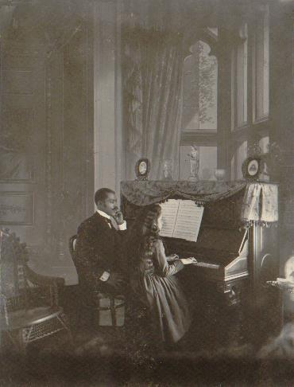
Commercial ragtime was transformed into a piano-based genre. As such, many women were involved as performers and composers.
In America, women comprised the majority of pianists during the ragtime era

Slide 7
It is not surprising that they wrote and performed rags
A well-worn copy of Adaline Shepherd’s “Pickles and Peppers” Rag

Slide 8
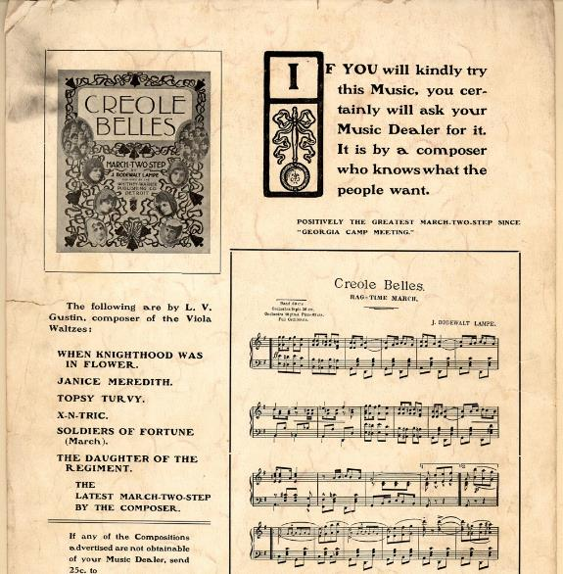
There were over 400 women rag composers, but their identity was often masked with pseudonyms and initials. In this ad, composer Louise Gustin is addressed as L. V. Gustin, and was probably assumed to be male.

Slide 9
The connection between women, piano, and jazz continued as new jazz forms emerged. Mary Lou Williams (1910-1981) became the piano “superstar” of jazz historiography, often listed as the lone woman instrumentalist among groups of men.

Slide 10
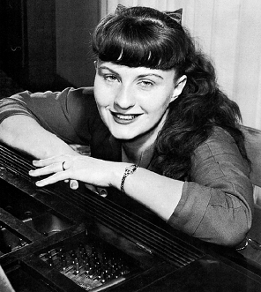
In truth, significant numbers of women were involved. Shown here is German jazz pianist Jutta Hipp.

Slide 11
Other Instrumentalists
It was more difficult for women horn players and drummers to enter the gender-integrated big band scene
Informal social networking was the main access to gigs, and women were often cut off from the system
Women such as trombonist Melba Liston reported on-the-job prejudice, especially until they “proved themselves”

Slide 12
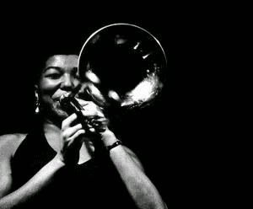
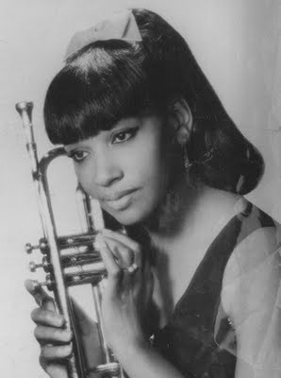
Melba liston (left) and clora Bryant (right) both described having to go above and beyond to “prove themselves” in the jazz world, despite their notable skill

Slide 13
Hundreds of all-women bands existed prior to 1950
Women in gender-segregated groups usually had to maintain a glamorous stage presence. High-heeled shoes, revealing clothing, and lipstick were required, often creating performance complications. Shown here is Vivien Garry.

Slide 14
Composer/Arrangers
Following in the footsteps of Melba Liston and Mary Lou Williams, many women performers have participated as jazz composers and arrangers .
Toshiko Akiyoshi is one notable example. Her charts are performed widely, and by 2010, she had received 14 Grammy nominations .
Carla Bley is among the most creative minds in modern jazz, a leader in the experimental movement.

Slide 15
The roots of gender segregation in jazz are still somewhat evident today. Jazz is a “gigging” culture, with informal invitations to participate. Women have made great strides breaking into the system, but some still prefer the all-women model.

Slide 16
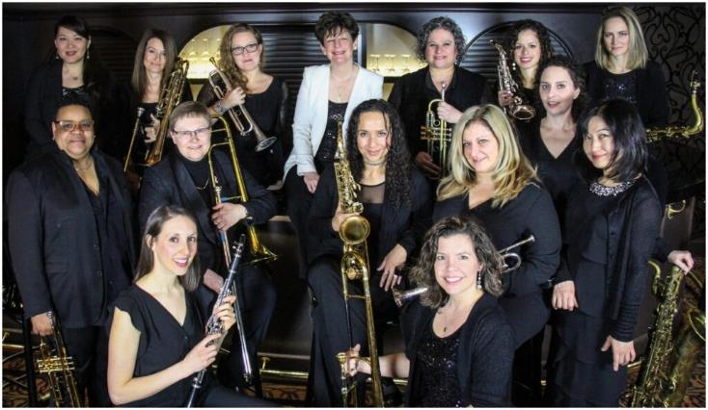
Voluntary Segregation
Groups like DIVA, led by drummer Sherrie Maricle, have experienced commercial success both with standards and by featuring charts written and arranged by women.

Slide 17
Summary
Jazz has been presented historically as a “man’s world,” but women had fundamental roles to play throughout its history
Deeply-held sexist beliefs about some aspects of jazz performance are changing. Still, a 2020 image search of “jazz performers” (right) reveals how the story remains told

