Slide 1
Women, Music, Culture Chapter 8
American Popular Music:
1895-1945

Slide 2
Chapter Focus:
Popular music not only entertains; it reflects societal values
Recognition of women as performers of popular music has been impacted not only by gender, but also by race

Slide 3
Amateur and Professional Roles
In the late 19th century, many white women were musical entertainers in the home. American homes often had a keyboard instrument of some kind, such as this parlor organ.
Photo courtesy of the Library of Congress

Slide 4
Sheet Music
Sheet music was distributed in magazines

Slide 5
By the turn of the 20th century, many women were taking music lessons on instruments such as the violin
Even the most accomplished performers were restricted to amateur ensembles

Slide 6
Professional groups were closed to women
1907 Chicago Symphony Orchestra photo: Courtesy of the Library of Congress

Slide 7
Many accomplished white women performed in gender-segregated ensembles, but most were amateur groups

Slide 8
instrumentalists in professional settings were often treated as visual side shows 1898 Circus Poster, Courtesy Library of Congress

Slide 9
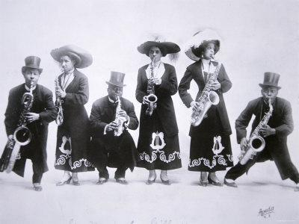
In contrast, Black women often performed as paid professionals, even in gender integrated settings (especially in family groups.) Many stated that racism restricted their public musical activities more than sexism Pictured: The Musical Spillers

Slide 10
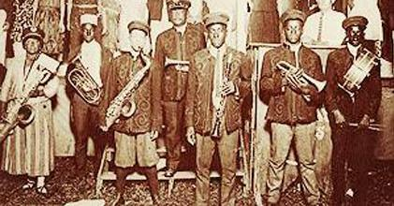
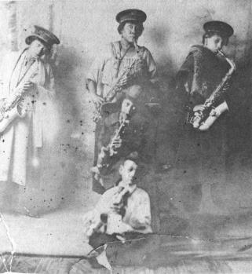
This was common in vaudeville, concert bands, and other forms of popular music Pictured: top: sarah Young, at left, performing with the Young Family Band, 1924. Famous saxophonist lester young is in knickers, to her right. Rutgers University Digital collection. Bottom: Lester young, seated on stage, with sister irma seated in chair just above him.

Slide 11
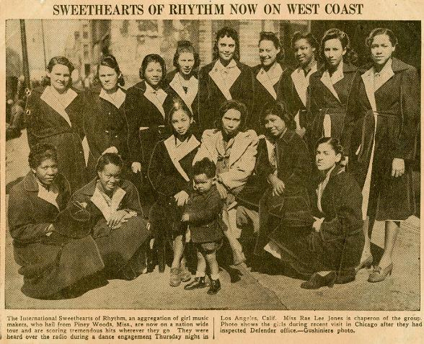
Gender-segregated instrumental groups also performed professionally, and were highlighted frequently in the Black press.

Slide 12
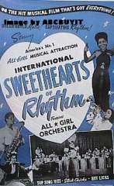
Sometimes these groups were marketed as “visual attractions.” Pictured here are the International Sweethearts of Rhythm in a film advertisement.

Slide 13
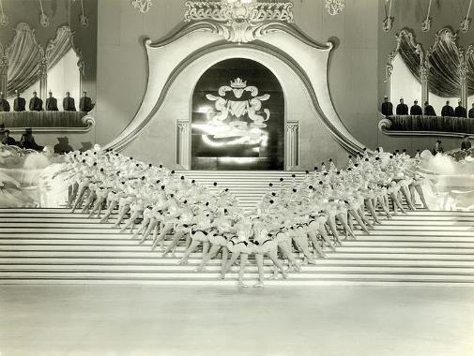
The Spotlight on Vocalists and Dancers
Women solo singers and dancers often were placed “front and center” on stage and in advertising

Slide 14
With roots in the military, concert bands featured all male instrumentalists, but women vocalists were featured as “special attractions” that fronted the band.

Slide 15
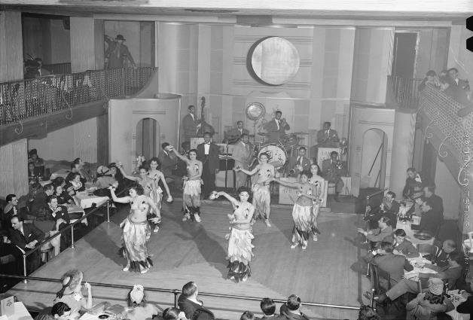
roles for women in jazz also were often restricted to front and center, as much a visual attraction as a musical one. Photo: Library of Congress

Slide 16
Like many jazz vocalists, Billie Holiday began her career in the “canary Role,” spotlighted in front of all-male big bands

Slide 17
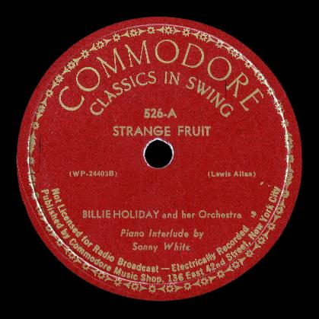
In her solo career, holiday entertained, but also addressed social justice. “Strange Fruit” made white americans more aware of lynching, for example

Slide 18
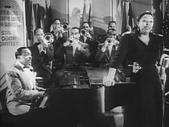
Ethel waters, shown in the “canary Role” here, also was featured in films

Slide 19
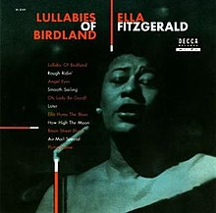
Ella fitzgerald
Black performers like Holiday, Waters, and Ella Fitzgerald endured racism and discrimination as they toured the country, even as they soared to popularity before a racially diverse national audience.

Slide 20
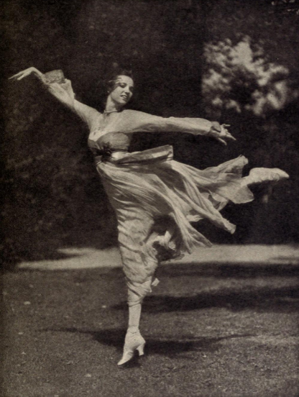
Dance
Dancing was considered an acceptable profession for women in the world of popular music entertainment in the first half of the 20th century

Slide 21
Vern and Irene Castle taught dance lessons from their rooftop studio in New York City

Slide 22
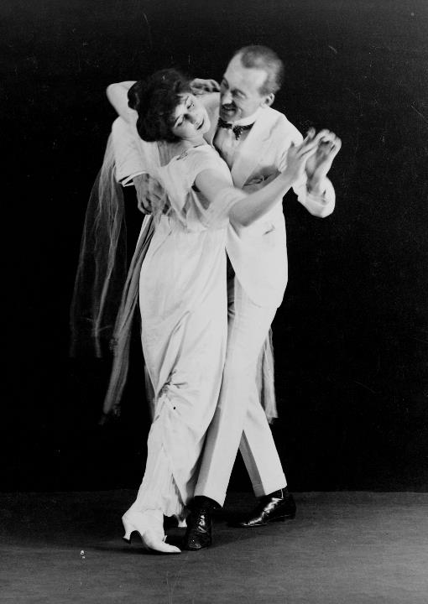
Irene Castle’s slender figure and shoulder-baring dresses were admired and imitated. Photo Courtesy of the Library of Congress

Slide 23
The Castles adapted and “re-taught” many black dance forms that became widely popular with white Americans William Gottlieb Collection, used with permission

Slide 24
Jitterbug Dancers in 1938 Courtesy of the Library of Congress

Slide 25
Stage Shows
Regardless of race, women found a significant amount of work in staged productions such as vaudeville shows, follies, and musical reviews
Much of this music was distributed to the public through the sheet music industry

Slide 26
Tin Pan Alley
Tin Pan Alley refers to a popular music style as well as a sheet music publishing industry
It was a major distributor of American popular song between 1880 and 1950, much of which was connected to stage shows and movies

Slide 27
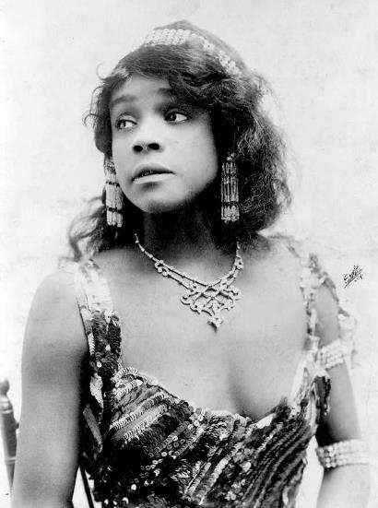
Aida Overton Walker sang, acted, and danced as part of the Williams and Walker Act

Slide 28
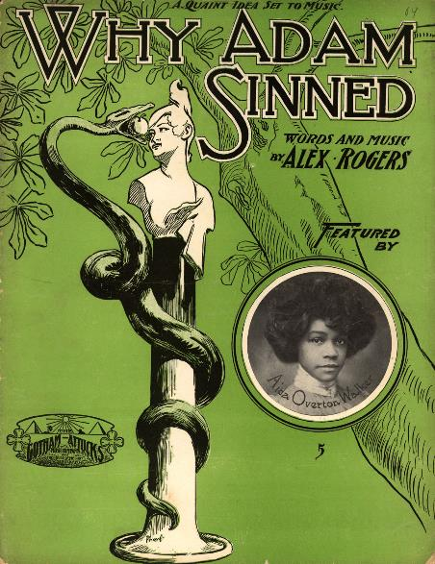
Popular performers like Walker were featured on sheet music covers

Slide 29
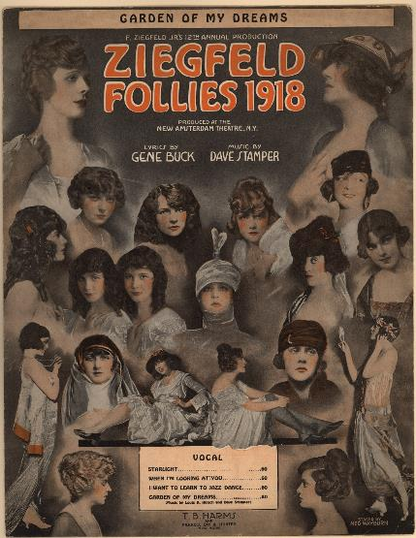
In this Tin Pan Alley sheet music cover, women of the Ziegfeld Follies stage show are advertised as part of a “Garden of Dreams”

Slide 30
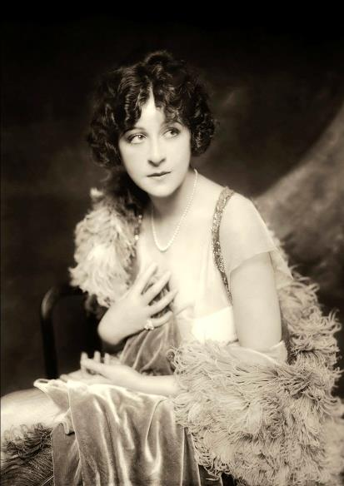
The attire on Ziegfeld follies performer Fanny Brice was considered daring for its time

Slide 31
Men from the same company were presented quite differently

Slide 32
Composers
Carrie Jacobs Bond is just one of the prolific women composers and publishers of Tin Pan Alley. A single mother, she began her business in the corner of a small apartment

Slide 33
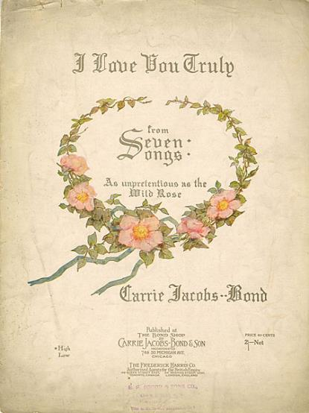
Bond did everything herself, including composition, marketing, and artwork for the sheet music covers

Slide 34
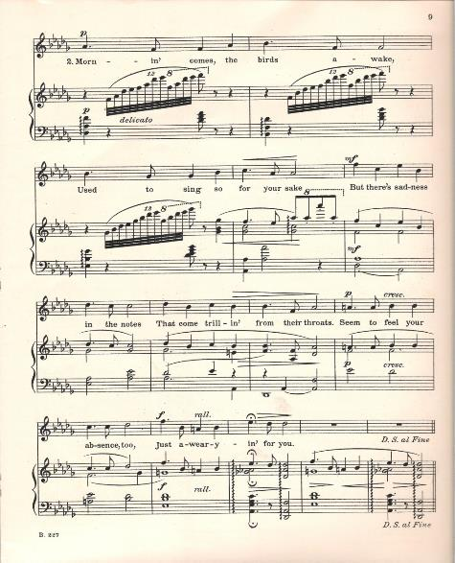
Like many women in the popular music industry, Bond had significant classical training. This song is indicative of her education in terms of the difficulty of the piano part.

Slide 35
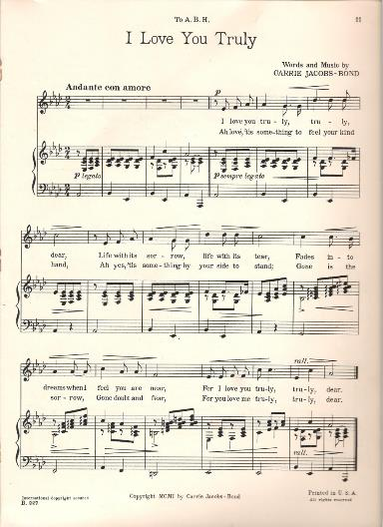
Bond’s popular “I Love You Truly” featured a simpler accompaniment and a modest vocal range that stayed within an octave

Slide 36
Summary
Women found great success in American popular music between 1895-1945 but were limited to performance areas that were considered acceptable for their sex
White women who abandoned culturally-defined gender roles in music often performed in amateur groups, while women of color performed professionally, and noted that racism was a bigger factor in limiting performance options
Regardless of race, visual portrayals of women musicians in advertising and marketing differed significantly from that of male musicians

