Slide 1
Women, Music, Culture Chapter 9
Empowered Voices in the Public Eye:
Women of Gospel and Blues

Slide 2
Chapter Focus
The stage has sometimes been a place of tremendous power for women
Women of blues and gospel negotiated a music industry that catered to the male gaze
They strongly impacted the sound of American popular music
They also used the stage to disseminate messages of importance to them

Slide 3
The Power of Text in the Black Tradition
From spirituals to rap, musically-delivered texts have been of great importance in the Black community
Social messages were often delivered through music

Slide 4
Sojourner Truth, b. 1797, used hymns and secular songs to address equality and freedom

Slide 5
Harriet Tubman (b. 1820) used songs to instruct people who moved to freedom on the Underground Railroad. Texts often had double meaning, providing practical instructions as well as encouragement.

Slide 6
Scholar Bernice Johnson Reagon indicates:
The lyrics of “Wade in the Water” instructed people to step into the water to avoid being tracked by dogs
The lyrics also noted the necessity of walking through trouble, not around it, on the path to freedom

Slide 7
Gospel: black religious music that emerged in urban centers in the early 20th century
Men comprised the majority of black preachers during the first half of the 20th century, but women comprised the majority of church members
Women were deeply involved in music ministry
For Black women, gospel music was a “pulpit” for sharing their collective message

Slide 8
The commercialization of gospel allowed spiritual messages to spread widely on records and radio, but not without controversy
As women adapted their attire and stage presentation to reach mainstream audiences, church critics charged that the gospel message was becoming lost

Slide 9
Mahalia Jackson was generally regarded as a devout carrier of the gospel message

Slide 10
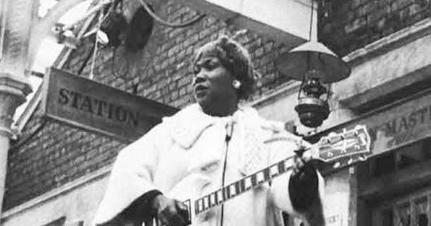
Sr. Rosetta Tharpe is a gospel artist who was condemned for blurring the message

Slide 11
Performers like Tharpe had a strong impact on the sound of popular music in the latter half of the 20th century
Notably, early rock directly emulated gospel’s ornamented wail, rhythmic drive, pitch bending, and emotion

Slide 12
Blues: Another Pulpit
Like their counterparts in gospel, blues women delivered important social messages as they forever impacted the sound of popular music

Slide 13
Ma Rainey was a vital link between the rural and classic blues style

Slide 14
Classic blues singers such as Bessie Smith projected images of strong women. Blues songs covered issues ranging from poverty and illiteracy to power relations with men.

Slide 15
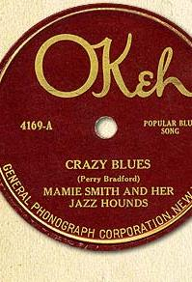
Like gospel, blues songs were widely distributed on commercial recordings

Slide 16
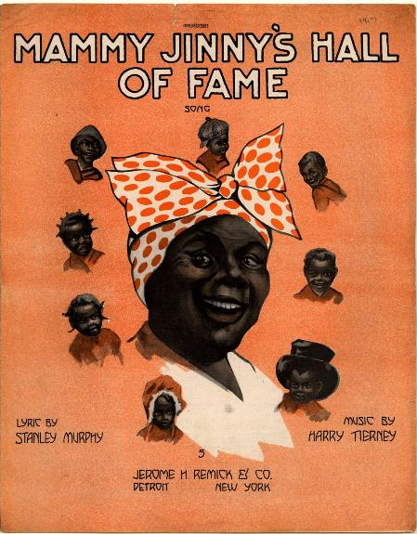
The blues singer was publicly deified in a manner that rejected former stereotypes of black women, including the “mammy” stereotype, seen on this 1917 sheet music cover Duke University Sheet Music Colletion

Slide 17
Gospel and blues styles shaped the sound of popular music styles, including…
Rock
Country
R & B
Soul
Rap

Slide 18
Final Thoughts:
Gospel and blues were forged in part by a music industry eager to make money
Mass marketing sometimes led to a loss of authenticity. Sometimes women were exploited, especially when original tunes were “covered” by other artists
The industry also provided an avenue for women’s empowerment, and a chance to widely address issues ranging from equal rights to civil rights

