Slide 1
Reflections on “Deep Listening”
Women, Music, Culture
Chapter One
Exploring Music in Context

Slide 2
Listen…
To the sounds within you
To the sounds around you

Slide 3
Is it Music?
Who Decides?

Slide 4
Some balance of unity and variety in sound is perceived as music, but the balancing point varies by individual

Slide 5
Musical elements are used in a variety of ways, depending on culture, but sociocultural beliefs also impact our perception of music.

Slide 6
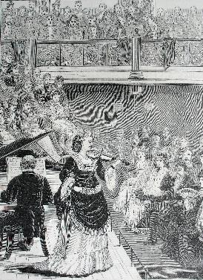
In some cultures, the soft sounds of acoustic strings are considered “proper” for women. Today, violin and acoustic guitar rest comfortably in the Western “female sphere.”

Slide 7
Contrastingly, electricity, technology, and “loudness” historically have been associated with men. As such, women who play electronic strings are sometimes considered unusual. How many current rock guitarists can you name? How many are women?

Slide 8
In general, instrumentalists have been linked to the male domain in Western culture. In jazz, for example, the majority of documented big bands have been all-male.

Slide 9
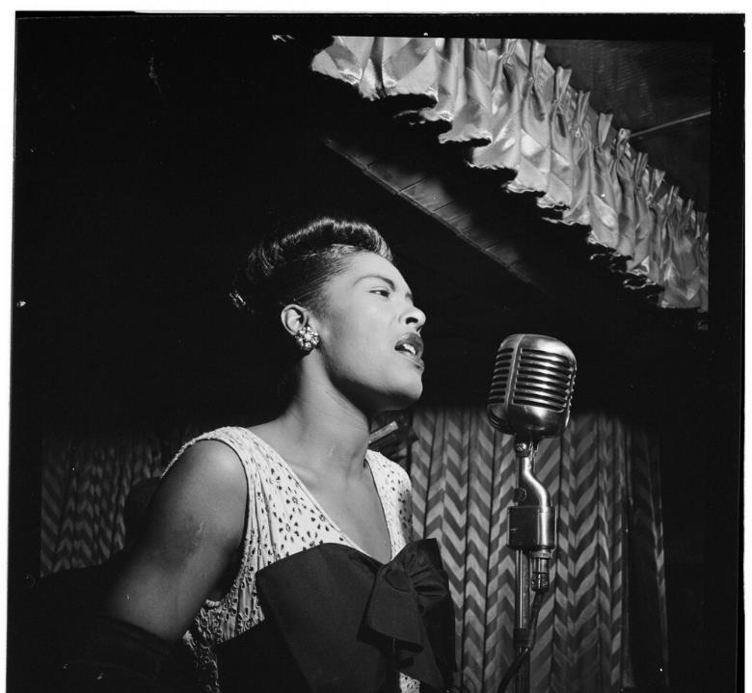
The majority of documented jazz vocalists have been women.

Slide 10
Additionally, certain musical genres are perceived as “worthy” of study, while others have been considered “less worthy”

Slide 11
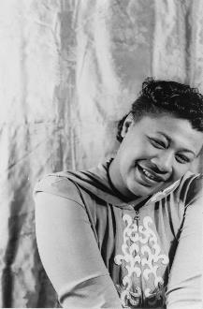
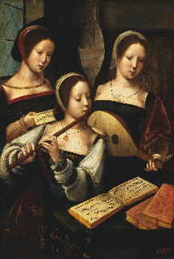
Music of everyday life has been considered of lesser importance
Art music has been held in high regard in academe
Popular music performers have been held in high regard by the public

Slide 12
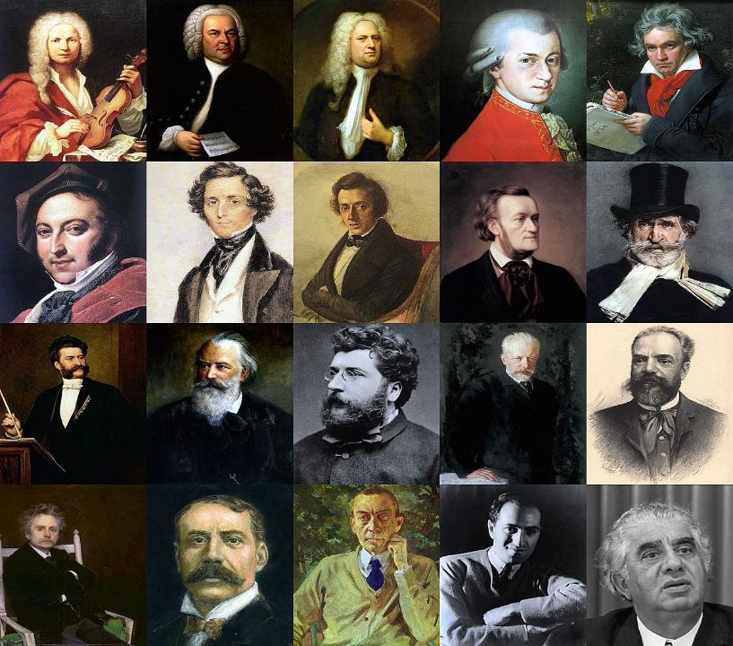
These long-held academic traditions continue to impact what we believe to be true about musical roles related to gender

Slide 13
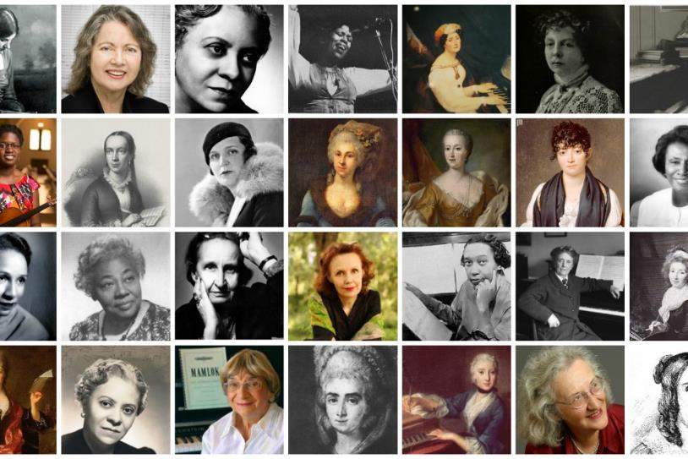
In this chapter, we will examine several musical examples to address how narratives and historical accounts impact our beliefs not only about music, but about many other things as well.

Slide 14
Popular Music Beyoncé's video album Lemonade addresses current sociocultural issues that have resulted from enslavement and patterns of family separation. The album is also used to preview differing beliefs about feminism.

Slide 15
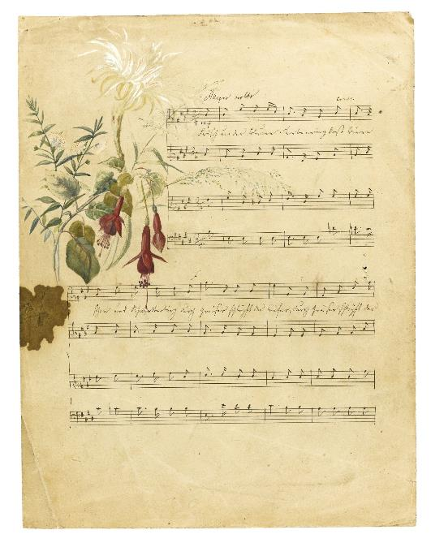
Art Music: By comparing and contrasting art songs by 19th century composer Fanny Mendelssohn Hensel and Harlem Renaissance composer Florence B Price, we see evidence that cultural beliefs about gender, race, and socioeconomic status impact perceptions about the worthiness of music for publication.

Slide 16
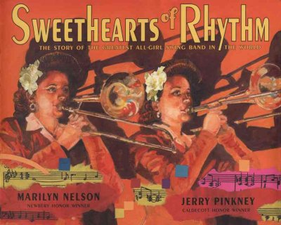
Using jazz as an example, we will specifically address how historical narratives themselves are impacted by factors other than gender

Slide 17
The textbook also is intended to help you critically read historical narratives of all kinds. By the end of the semester, you should be able to…
Consider cultural context and historical frameworks
Think about possible omissions. Are there “missing voices?”
Search beyond the text for alternative narratives

