Slide 1
Women, Music, Culture Chapter 7
Romantic Era Performer/Composers:
Walking the Public/Private Line

Slide 2
Social Class and Musical Expectations
In the Romantic era, wealthy families still generated well-educated and well-known musicians
For the growing upper-middle class, however, women’s music education was often a preparation for roles in the home

Slide 3
Remaining in the home was considered a privilege for women. It was also the acceptable place for women to perform
Accomplished women musicians were often discouraged from publishing their works; publication was considered inappropriately “public”

Slide 4
The Salon and the Stage
The public stage was an important venue during this era, but it was generally discouraged for women
The salon was a place of musical sharing and arts promotion that included women
Women such as Fanny Mendelssohn Hensel had significant roles as performers and arts promoters in salon settings
Hensel was widely known as a musician, despite the semi-private nature of the salon

Slide 5
Fanny Mendelssohn Hensel (1805-1847)
According to many secondary sources, Hensel was subservient to her famous musical brother, and happily promoted his career rather than her own. In truth, she was a prolific composer who longed to publish her works.

Slide 6
Primary source materials such as Hensel’s diary indicate that she agonized over whether or not to publish
Letters from Hensel’s father provide evidence that he strongly discouraged her from performing in public and from publishing
Despite cultural restrictions, Hensel wrote over 400 works

Slide 7
With the encouragement of her mother and her husband, Hensel eventually sought publication
She died at age 41, within a year of her decision to publish
Felix Mendelssohn published some of his sister’s work after her death, including her Opus 11 Piano Trio

Slide 8
Much of Hensel’s work remains unpublished, and she still stands in the historical shadow of her brother

Slide 9
Gender Boundaries: Chamber versus Large-Scale Works
Chamber Music: music for performance by a small group, usually with one performer per part; originally for small audiences
Chamber music fit well with societal expectations for women

Slide 10
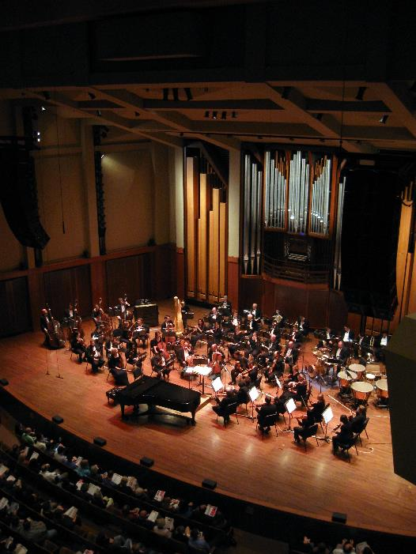
Large-scale works: genres that require large numbers of performers; also refers to genres that are of significant length
Large-scale works were performed in public spaces, and required significant knowledge of music theory, often inaccessible to women unless they were members of musical families

Slide 11
Gender Boundaries: Absolute and Programmatic Music
Absolute Music: music that does not seek to suggest a story or scene, but is concerned with formal construction. Often associated with the “male sphere”
Hensel’s Piano Trio in D Minor, Op. 11 fits this category

Slide 12
Program music: instrumental work that tells a story or suggests a non-musical idea.
Hensel’s Das Jahr “The Year” is a programmatic set of piano works that musically depicts the months of the year
Hensel’s brother was initially condemned for publishing the “feminine” piano character pieces Songs without Words

Slide 13
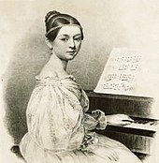
Clara Wieck Schumann (1819-1896) Composer and Virtuoso Performer Subject of Conflicting Narratives

Slide 14
Clara Schumann’s narrative has been subject to significant alteration over time
Despite this, she was long cast as a performer who gave up her art during her marriage, making her fit a socially expected role
In truth, she performed throughout her marriage, even throughout the ten-year period during which eight children were born to the family
By the end of her career, Schumann had performed 38 extensive foreign tours, and enumerable concerts in Germany

Slide 15
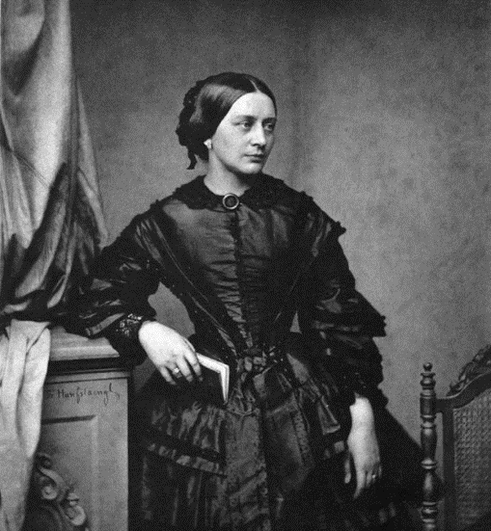
Clara Schumann AS A Composer
Clara was also a composer, and has at times been more recognized for her compositions than for her performance career. This is in spite of her own tendency to negate her role as a composer.
Musicology has traditionally honored composers rather than performers, often to the detriment of women who achieved great fame as performers.

Slide 16
Hensel and Schumann rose to prominence in a world that strongly suppressed public musical roles for women
Today, the “sister of Felix Mendelssohn” and the “wife of Robert Schumann” are returning to the position of renown that they once held in their own lifetimes

