Slide 1
Medieval Liturgical Roots and the Documentation of the Western Canon
Women, Music, Culture Chapter Two

Slide 2

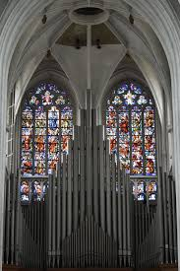




Judeo-Christian traditions impacted the formation of the Western art music canon
Public-sphere worship and rituals included music

Slide 3
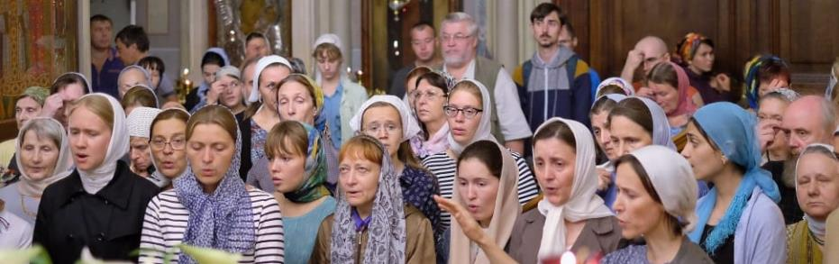
Women were banned from participation in public-sphere liturgical music
In Orthodox Judaism, women were not allowed to sing in the presence of men
Women could not officially sing during the Christian Mass until after 1900

Slide 4
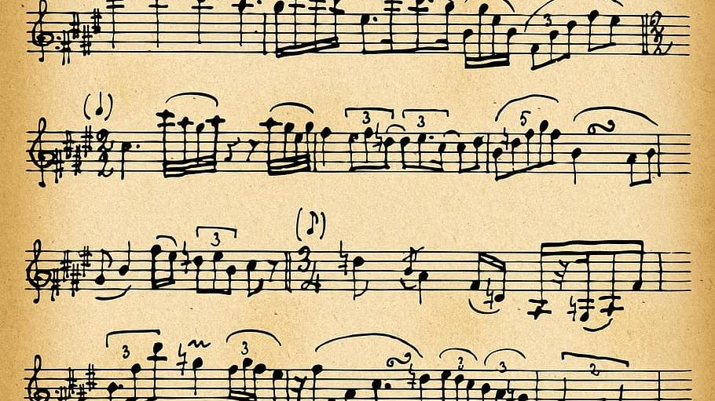
Music from public-sphere rituals was preserved by the Christian Church and was studied in educational settings

Slide 5

Written music was widely distributed. For centuries, texts were set in Latin.

Slide 6

Across cultures, a standard body of chant was used. Here is a Kyrie setting associated with the Christmas Mass.
Source: Liber Usualis

Slide 7
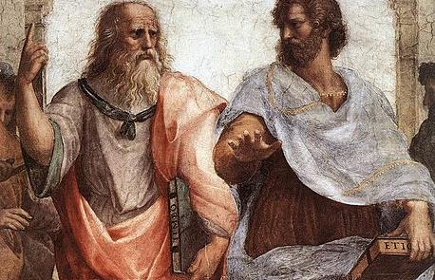
Women were usually banned from accessing formal education.

Slide 8
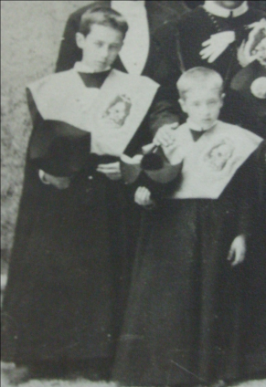
Similarly, church-sponsored music education institutions (such as the schola cantorum) were only open to men and boys.
Below, choir boys in 1899.

Slide 9
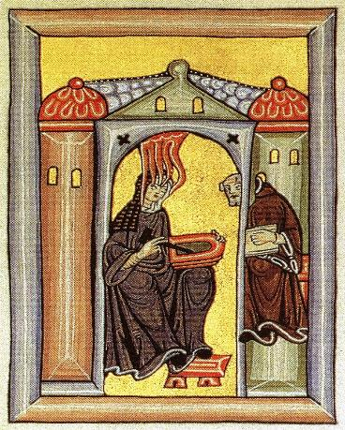
Convents were an exception— a place of educational and musical freedom for women
Hildegard von Bingen wrote a significant amount of music, much of which was performed in her convent

Slide 10
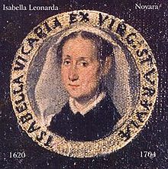
Baroque composer Isabella Leonarda also composed in her convent in northern Italy
Along with writing sacred vocal music, Leonarda is the first known woman to publish string sonatas.

Slide 11

Unlike Hildegard and Leonarda, most nun composers remain unnamed

Slide 12

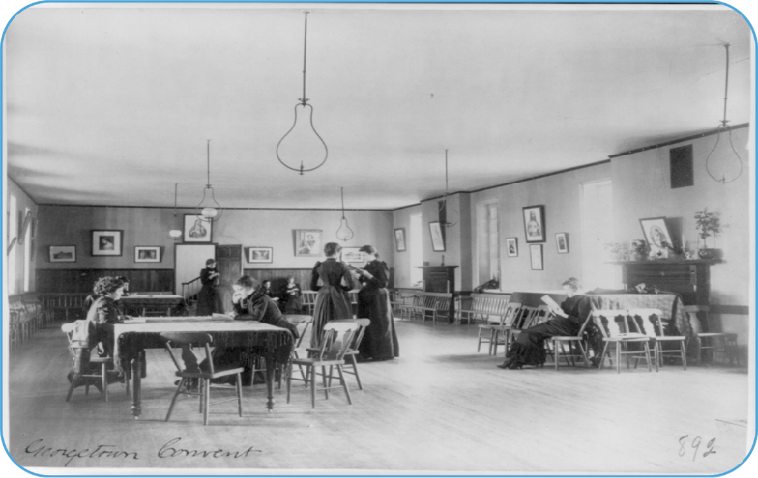
Even at the turn of the 20th century, women in professed religious communities had significantly better access to education than did other women.
Left, women studying in a Georgetown Convent c. 1900
Photo courtesy of the Library of Congress

Slide 13
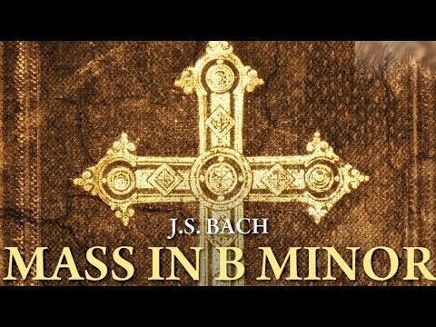
Ancient traditions left a lasting impact on the Western art music canon
Some sacred genres eventually functioned as concert pieces rather than as liturgical works

Slide 14
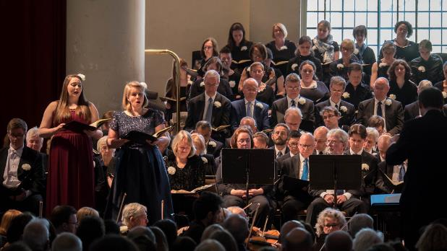
Sacred genres written throughout the centuries are still performed and studied today
Mass
Motet
Magnificat
Vespers
Oratorio
Cantata
Anthem
Hymn
Passion
Requiem

Slide 15
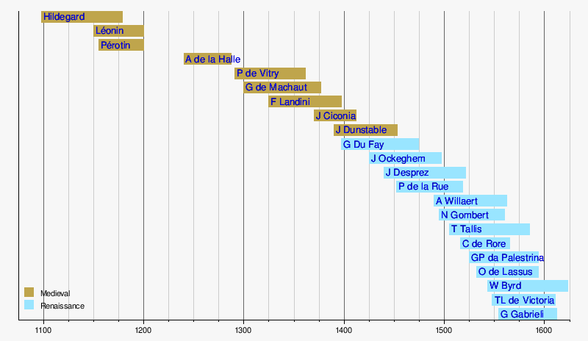
These works, and those who composed them, also became core components of musicological study

Slide 16
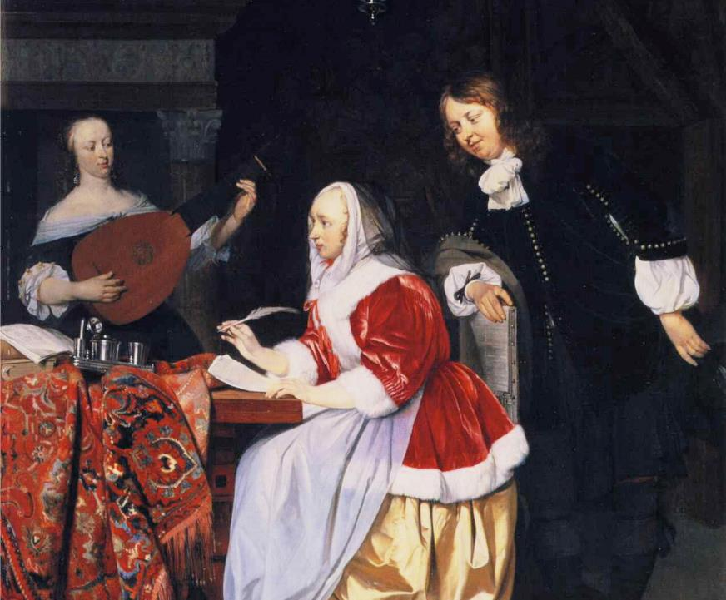
Preservation of a canon that initially restricted women contributed to the belief that women “could not” compose

Slide 17
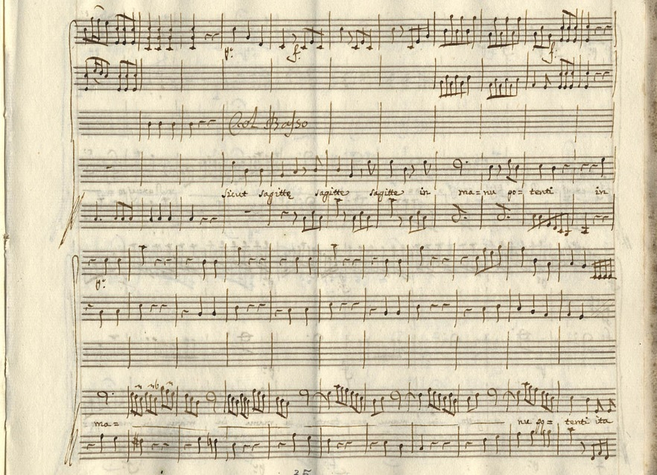
The vast majority of published sacred works by women date from the latter half of the 20th century to the present, due to educational and publication access.

Slide 18
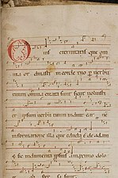
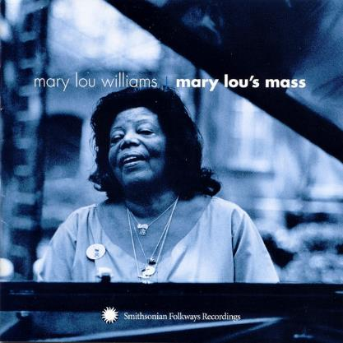
The Chapter Examines Works by Early Nun Composers, as Well as Modern Works
Hildegard von Bingen Isabella Leonarda
Mary Lou Williams Sara Parkman

