Slide 1
Women, Music, Culture Chapter 5
Baroque Keyboard and Vocal Genres:
Gender Roles in Musical Families

Slide 2
Musical Employment for Women
Artisan-class musical families were often employed in court settings
Women in these families had significant musical education and skills and served various court functions

Slide 3
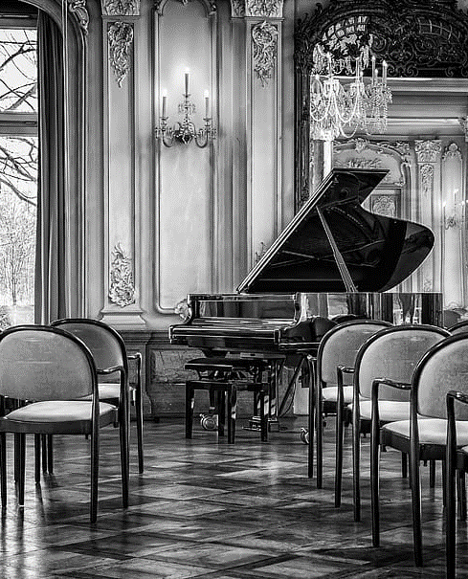
Some common roles for women:
Keyboard Performers
Vocalists
Composers
Teachers
Outside of the court setting, artisan-class women
were also involved in family-run musical businesses
such as instrument building

Slide 4
The Baroque Aesthetic and Notions of Women
The Baroque aesthetic is one of emotional energy, with an affective goal of eliciting an emotional response in the listener
This aesthetic fit well with societal notions of women
By the dawn of the Baroque, vocal and keyboard performance had already settled comfortably into the “female sphere”

Slide 5
Genres, Gender, and Boundaries
Women were still prohibited from most court-based sacred music performances
Women often performed secular keyboard and vocal works. Many of these performers composed as well, and sometimes their work was published.

Slide 6
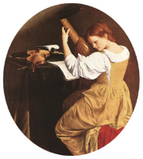
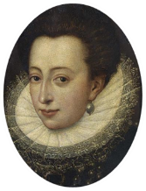
Italian Wealth: Caccini and the Women’s Court
Francesca Caccini (1587-1641) was employed by the wealthy Medici family in Florence, Italy. As an artisan-class employee, she was not likely to have had her portrait painted, although this image is often connected to her.
Although she worked for the entire family, Caccini was especially connected to the women’s court. Her sponsor was Christine de Lorraine, (left) who managed all aspects of that court. She likely paved the way for Caccini to publish works in her own name.

Slide 7
Caccini’s published works include an extensive collection of vocal works probably used as teaching pieces, as well as the staged work La Liberazione di Ruggiero dall’isola d’Alcina, performed at the women’s court in 1625

Slide 8
Barbara Strozzi: (1619-ca.1677)
Barbara Strozzi’s secular vocal works fit well into the socioculturally-defined “feminine” sphere. Her works featured ornamented melodies, and were topically centered on love.
Strozzi wrote more secular cantatas than any other composer of her era.

Slide 9
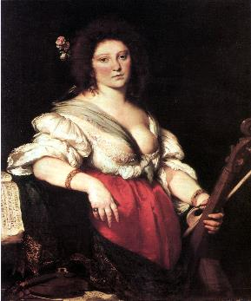
Strozzi and the Academy
Strozzi lived and worked in Venice among an academy of male intellectuals, the Academy of the Incogniti. She was restricted from performing among the greater public, but was well known because she was widely published.

Slide 10
Despite Strozzi’s renown during her lifetime, the death of her father spelled the end of her connection to the public. Even the exact date of her death is unknown.
Strozzi’s prolific work was rediscovered in the 20th century, at which time her name once again became known to a wider public.

Slide 11
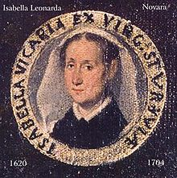
Isabella Leonarda: The Italian Baroque Convent as a center of composition
Isabella Leonarda was a nun who composed in her convent in northern Italy

Slide 12
Leonarda had connections to publication through church personnel who also were relatives

Slide 13
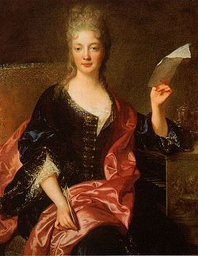
Guerre in the Court of Louis XIV
Elisabeth-Claude Jacquet de la Guerre (1665-1729) was employed by the court of Louis XIV in France

Slide 14
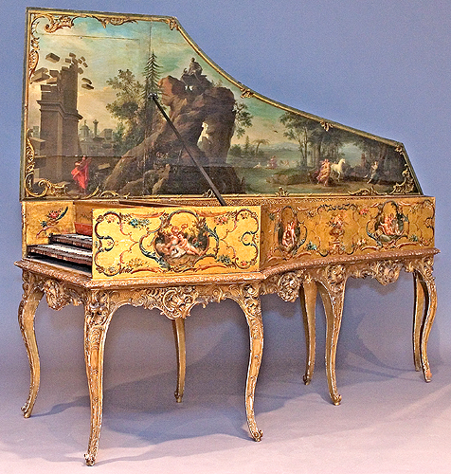
From an artisan-class family of harpsichord builders, performers and teachers, Guerre’s astounding performance skills earned her a long connection to the “arts king.” Among the benefits were publication rights. (At left, a Baroque-era harpsichord)

Slide 15
Guerre was the only composer to publish harpsichord suites in both the 17th and 18th centuries
She was included in early musical catalogues and dictionaries, including those of Burney and Hawkins in England and Johann Walther in Germany

Slide 16
Like other women who composed, however, Guerre was written out of historical accounts in the 19th and early 20th centuries in favor of male composers

Slide 17
The pages of recorded history that erased the narratives of composers such as Caccini, Strozzi, Leonarda and Guerre are slowly being replaced by new narratives
Women who were published had significantly more evidence to support the reconstruction of new narratives detailing their musical accomplishments

Slide 18
Women who could not access publication remain relatively unknown.

