Slide 1
Women, Music, Culture Chapter 6
Eighteenth Century Classicism:
Revisiting Vienna

Slide 2
Chapter Focus
The monuments of modern Vienna reflect a narrative where music is presented as a “man’s world” during the Classical era (roughly 1750-1820)
This chapter is a reconstruction of Classical-era Vienna. It highlights the work of women who were performers, composers, instrument builders, and patrons of the arts
Men and women engaged in the musical life of Vienna, and together impacted the course of music history

Slide 3
Vienna, Austria
One-time home of a long list of revered composers such as Mozart, Haydn, Beethoven, Schubert, Strauss, Mahler, Bruckner, and more
Also home to revered performance venues and longstanding ensembles such as the Vienna Boys Choir and the Vienna Philharmonic

Slide 4
Vienna’s famous male composers are immortalized both in historical accounts and in museums and monuments throughout the city.
The focus on the composer as center of the musical narrative is longstanding. In reality, composers do not work alone…

Slide 5
Not just a Man’s World… Photo: Andrew Shiva

Slide 6
Composers Need Performers, Audiences, and a Way to Make a Living
Wolfgang Amadeus Mozart (1756-1791) was one of the first composers in Western music history to attempt to make a living as a freelancer.
Without a steady paycheck from an employer, he relied on multiple revenue streams to support his family
In Vienna, Mozart taught lessons, wrote commissioned works, and performed in salon settings. All of these activities had connections to women in Vienna.

Slide 7
Women as Musical Sponsors
Sponsorship of the arts is essential to its creation, but sponsors are often overlooked. In Vienna, sponsors such as Teresa von Trattner, Josepha Auernhammer, the Countess Maria Thun-Hohenstein, the Baroness Martha Elisabeth Waldstatten, and the Empress Maria Theresa commissioned works, hosted musical events, and provided performance venues.
Without their support, the musical output of this era would have been greatly diminished

Slide 8
The Empress Maria Theresa commissioned works, hosted musical events, created performance venues, hired a large staff of composers and performers, and sponsored female musicians in the city Image: Library of Congress

Slide 9
Women as Composers: Marianna Martines (1744-1812)
Classical-era composers such as Marianna Martines are often overlooked due to the focus on Haydn, Mozart, and Beethoven.
Martines wrote over 200 works, some 70 of which survive
She was the first woman accepted into the prestigious Accademia Filarmonica of Bologna, Italy
She was highly regarded by musical historian Charles Burney, but later historians downplayed her work

Slide 10
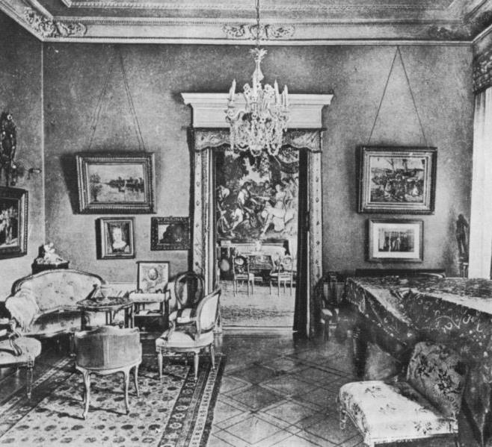
In addition, Martines’ salon was one of the most important concert venues in the city. The Classical salon provided an intimate space for invited guests to enjoy the best live music available.

Slide 11
Performer and Composer: Maria Theresia von Paradis (1759-1824)

Slide 12
Maria Theresia von Paradis was both a composer and a virtuoso pianist
As the notion of the public concert developed in Vienna (as opposed to the “by invitation” salon scene) Paradis was one of the city’s most revered performers
She additionally toured throughout Europe

Slide 13
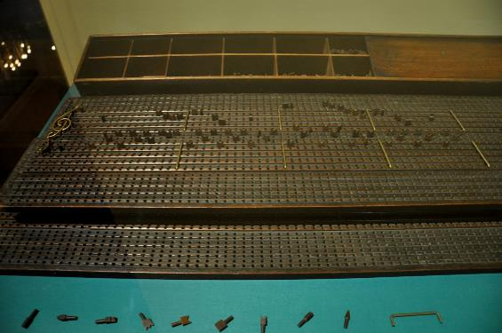
Paradis also established and taught in her own music school. As a blind performer and composer, she was a leader in pedagogy for the blind, and collaborated on a French school for the blind where Louis Braille was first a pupil, then a teacher. Pictured is the composition board that she used for writing music. Photo: Andreas Praefcke

Slide 14
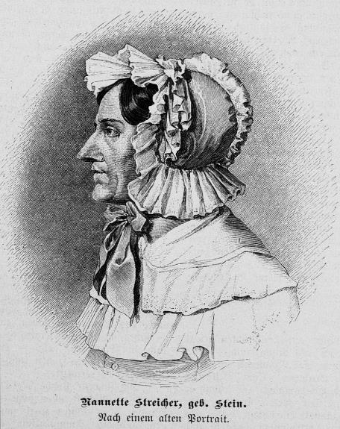
Piano Builder : Nannette Streicher nee Stein (1769-1833)
Nannette Streicher began working in the Augsburg piano shop of her famous father when she was 7. It was recognized that she had a gift for piano building. At age 10, she was making parts, tuning, and regulating piano keyboards
She took over her father’s business when she was 23 years old, and moved it to Vienna, where there was high demand

Slide 15
Piano Builder : Nannette Streicher nee Stein (1769-1833)
The Stein/Streicher piano firm was considered one of Europe’s leading piano factories
Stein contributed to the rapid development of the piano, adding keys, and experimenting with action and regulation
Stein was a friend and mentor to Beethoven as well. She custom-made pianos to his specifications

Slide 16
Piano Builder : Nannette Streicher nee Stein (1769-1833)
The piano factory also had a performance room that could hold up to 300 people. It became a central gathering place for composers such as Hummel and Beethoven.
Brahms’ 1868 Streicher piano was given as a gift to the composer from the Streicher firm.
The multi-generation Stein-Streicher firm crafted approximately 8600 hand-made instruments and left a significant mark on the musical world

Slide 17
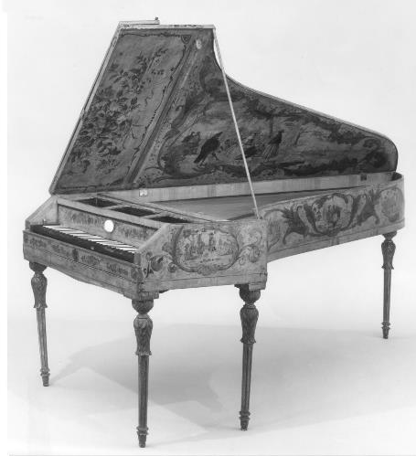
A Stein piano, circa 1794-1803, made of cherry wood. Image courtesy of the Metropolitan Museum of Art.

Slide 18
The World of the Performer: The Weber Sisters
Composers are usually documented more than performers, but in reality, the public revered famous performers. In fact, some composers were relatively unknown during their lifetimes.
The historical focus on composers negates the musical achievements of many outstanding women performers

Slide 19
Vienna’s “first family” of vocal performers were sisters Aloysia, Constanze, Josefa, and Sophia Weber
Mozart’s connections to the Weber family led to the composition of numerous works that were tailor-made to the sisters
This included several operatic roles, including the “Queen of the Night” from The Magic Flute
The high vocal range and the vocal agility of the Weber sisters influenced the music that Mozart composed for them. These works are an important part of the Western art music canon today.

Slide 20
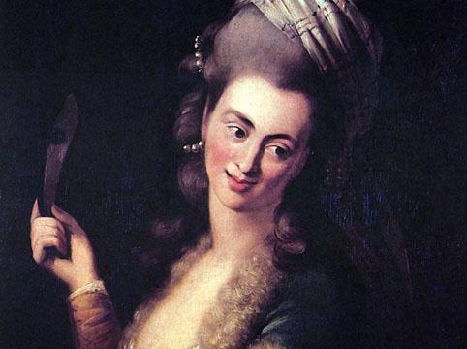
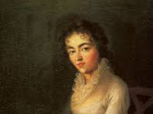
Aloysia Weber Lange, dressed for a stage role
Constanze Weber Mozart, who married the famous composer

Slide 21
Not Allowed: When Women Musicians are Restricted
There is much to celebrate in terms of what women contributed to music in the Classical era. At the same time, many women were restricted in their public musical activities.
Many women, including the gifted Maria Anna (Nannerl) Mozart (1751-1829), were not allowed to perform in public once they reached adulthood
In addition, it was difficult for many women to publish their compositional work

Slide 22
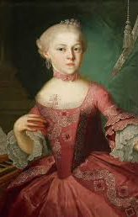
Nannerl Mozart
Like her younger brother, Nannerl Mozart was a child prodigy who performed throughout Europe. She was pulled from the concert scene when her father declared that it was inappropriate for an adult woman to perform in public.

Slide 23
Summary
Women were key players in the world of Classical art music as composers, performers, instrument builders, and sponsors
Women and men participated together in creating the musical world of the Classical era, but traditional musicological narratives preserved the stories of a limited number of composers
Because there was no recording technology during this period, it is difficult to fully appreciate the achievements of performers, many of whom directly impacted the Classical music that was written and preserved

