Slide 1
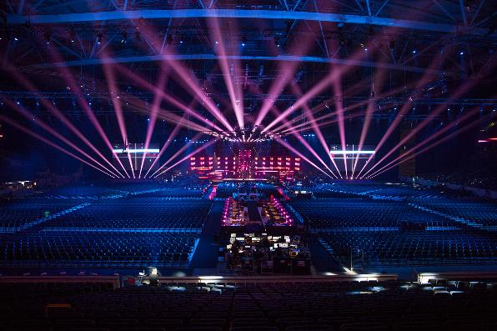
Women, Music, Culture Chapter 16
Popular Music as a Feminist Platform:
Women in Charge of Production and Management

Slide 2
Focus
The music industry is an immense and complex system with multi-billion dollar yearly revenues
The bottom line: making a profit
Cultural perceptions about women impact how music is marketed to create sales within this industry
Many women have turned to production to ensure the delivery of messages important to them, including feminist messages

Slide 3
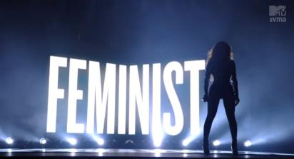
On stage, feminism has been expressed in myriad ways, from reclaiming misogynist lyrics to purposefully using the body for self-commodification.
Using a lens of intersectionality, this chapter addresses how feminism is defined, expressed, and received in the pop music world
Intersectionality: a theory that views discrimination and systemic oppression as a result of the intersection, or overlapping, of social identities such a gender, race, sexuality, and class

Slide 4
The Inner Workings of the Traditional Industry in the 20th century: What Stood Between the Artist and the General Public?
Artist search team
Marketing experts
Production team
Distributors
Business/legal experts
Manager
Sound Engineers and Producers
Press and promotion experts
AND MORE!

Slide 5
In this system, musicians were considered “product”
In popular music, it has been easier to “sell” products that fit culturally-defined musical expectations
Women folksingers and singer-songwriters have done well in the market—how many can you name?
Rock guitarists have had struggles—how many women can you name?
Beyond musical ability, it has often been necessary to have a certain “look”

Slide 6
“alternative” artists often sought alternative ways to distribute messages of value to them Punk and other “underground” movements distributed music by using inexpensive recordings and fanzines (zines)

Slide 7
Owning the Label
In more widely commercial genres, some women found it necessary to form independent labels to take control of the content of their lyrics

Slide 8
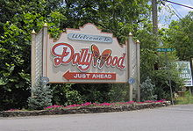
An Early pioneer: dolly parton
In country music, Dolly Parton addressed feminist themes in songs such as “Coat of Many Colors,” which highlighted women’s resilience, and “Down from Dover,” which addressed being pregnant and abandoned.
By breaking with her manager and creating her own empire, Parton’s business savvy blazed a trail in marketing country music more widely
Parton’s lyrics stand in contrast to country songs like “Stand By Your Man” that urged women to overlook cheating and mistreatment

Slide 9
1980s Rock: a commercial Breakthrough for Women
Post-punk genres such as New Wave led to great market success
Women in all genres began to get more press as it became clear that widespread commercial success was possible for female artists

Slide 10
the 1990s brought triumphs and trials
Artists like Celine Dion, The Spice Girls, Queen Latifah, Lauryn Hill, Selena, Shania Twain, LeAnn Rimes, Sarah McLachlan, Mariah Carey, and many others had unprecedented market success and began to win major awards
At the same time, music marketing dramatically changed due to internet downloading during this era
Resultantly, the music industry favored artists who could sell products and could cross into multiple music markets

Slide 11
“Manufactured” music became increasingly popular
Studio produced, often masking musical flaws
Sometimes features musicians with marginal talent
A “look” could sell products (including non-musical products such as fragrances and clothing) and was considered essential by many large companies
An unfortunate “sound” could be corrected in the studio

Slide 12
further… women continued to be objectified in the lyrics of many popular music genres
Rap: “she didn’t know what hit her…”
Country: “I got girls who cook, I got girls who clean…”
Rock: “Let me warn you, I'm coming for you…”

Slide 13
Women began to present alternative messages, especially when they operated as producers and label executives
“It's silly when girls sell their souls …”
Lauryn Hill
“A man don’t really love ya if he hits ya…”
Queen Latifah

Slide 14
3rd wave feminism on stage
There were conflicting views of how feminism was defined…

Slide 15
Two movements of the 1990s
Riot Grrrl
Girl Power
A third-wave feminist movement that lashed out against assimilation of male culture
Used “in your face” aggressiveness to address topics like rape, incest, and eating disorders in song lyrics
Exemplified by groups like Bikini Kill and artists like Alanis Morissette
Another third-wave feminist movement that favored empowerment for women
Focused on messages of sisterhood and unity, and confirmed femininity with high-pitched voices and dress code
Exemplified by groups like The Spice Girls

Slide 16
Hip hop feminist work reflected intersectionality, and themes of black feminism
Queen Latifah
Lauryn Hill
Addressed male domination and abuse while remaining firm in fighting with Black men for the liberation of all Black people.
Upheld the positive elements of rap by making it clear that real women dislike objectification and violence.
Latifah’s work, along with that of Salt-N-Pepa, exemplifies a Black feminist voice that engages in public dialogue with Black men with whom they shared concerns about racist policing and high incarceration rates.
Addressed Black feminist themes such as motherhood, faith, and self-respect
Explored historical sexual exploitation of Black women that impacted not only notions of women’s sexuality (the hypersexual “Jezelbel” stereotype that was used as a justification for rape, for example), but also addressed historical governance of Black women’s fertility.
Hill represented Black feminists for whom motherhood was an expression of self-respect, power, and independence,

Slide 17
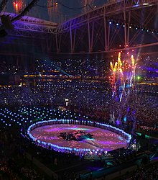
Beyond 2000
Women continued to have enormous success in the pop music market, earning huge salaries and gaining widespread fame

Slide 18
But there is Continued Debate about how Feminism should “appear” on stage
Feminists disagree about the authenticity of the feminist message in popular music.
For example, Taylor Swift has been accused of being a “fake feminist” because of her “man dependent” lyrics, especially early in her career
Artists like Beyoncé and Madonna capture positive attention for addressing women’s empowerment, but also receive criticism for using hypersexualized images, especially in videos.

Slide 19
Feminism and self-commodification of the body: another debate
On the positive side:
To have women fully in charge, the center of attention, owning their sexuality, and making salaries as large as any male artist in the industry is notable.
For women whose sexuality has historically been censured, sexualized performances can be a powerful way for women to reclaim sexuality on their own terms

Slide 20
But The issue is complex:
For example, women of color in particular have battled over-sexualization of their bodies. Stereotypes such as the Jezebel image (hypersexualized temptress) and the Latina dancer (associated with myths and stereotypes of female promiscuity) have historically been damaging to women.

Slide 21
Reclaiming images Where do you stand regarding the debate on hypersexualized imagery? Do you think

Slide 22
summary
Mainstream culture still expects women in popular music to display physical perfection
Women continue to be marketed in a manner that reaches dominant culture
Women continue to speak messages of importance to them via alternative genres, and by producing and promoting their own material
Feminism is expressed on stage in various (and sometimes conflicting) ways

