Slide 1
Large-Scale Works and Experimental Voices The 20th Century and Beyond
Women, Music, Culture Chapter 13

Slide 2
Chapter Focus
Access to education resulted in an explosion of compositional activity for women.
Music theory and orchestration coursework allowed women to explore large-scale and experimental works
Despite access to education, full integration of women in the field was slow.
Still, the 20th century marks the beginning of the most productive compositional period for women in music history.
The composers highlighted in this chapter are representatives of a vast field of women who compose. In no other portion of the text will so many worthy composers be left unmentioned.

Slide 3
By the 1870s, some European conservatories opened their doors to women, resulting in an enormous increase in the number of women who composed art music. At left, the library of the French Conservatory, 1895

Slide 4
Still Roadblocks
Many 20th century composers made a living as university professors, a profession difficult for women to access prior to 1950
Even the best-educated composers had difficulty accessing ensembles, and fought to hear their works performed
Recordings of women’s large-scale works have thus been difficult to obtain

Slide 5
Despite these obstacles, women achieved success.
z

Slide 6
Amy Beach (1867-1944): The Symphony at the Turn of the Century
As intellectually gifted as she was musically talented, Beach taught herself orchestration by reading textbooks and studying scores after being denied access to formal compositional study in the United States
Photo courtesy of the Library of Congress

Slide 7
Beach is probably best known for her Symphony in E Minor, “The Gaelic”
Less documented is the fact that she embraced emerging styles and techniques throughout her career
After her husband’s death, she returned to the concert stage as a performing pianist, reviving the career she had been denied at the request of her spouse

Slide 8
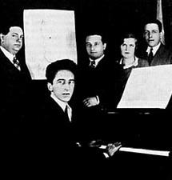
Germaine Tailleferre (1892-1983) Tailleferre was a member of Les Six, a prominent group of French composers from the early 20th century
z

Slide 9
Though her father opposed her study at the French Conservatory, Tailleferre paid her way through scholarships and teaching.
She received more conservatory composition prizes than any other member of Les Six, but did not receive nearly as much historical documentation as her male peers.
Partly to blame is that Tailleferre’s best compositions were large-scale works, many of which were not recorded until the turn of the 21st century.
Accessing performing forces for large-scale works remained a significant obstacle for women composers in the early 20th century

Slide 10
Florence Price (1887-1953)
Price was the first African-American woman to receive recognition as a composer
She frequently wrote to conductors, asking that they consider her work on its merits
She is known for incorporating Black vernacular music sources into her art music works

Slide 11
Until very recently, however, Price’s work has been under-reported in academic materials
This is in part due to stereotypes about genres and styles that have been associated with Black musicians
Many people assume that Black musicians are experts in jazz and blues, for example, but do not associate Black musicians with European art music
An example: Price noted that a publisher attempted to edit one of her art music compositions to make it more “jazzy”
In truth, Price used vernacular music as a source to infuse into European art music genres

Slide 12
Ellen Taaffe Zwilich (b. 1939)
Zwilich represents women who received advanced music degrees in the latter half of the 20th century
Her personal performance skills, ensemble experience, and compositional knowledge result in technically challenging works known for their fine musical construction
Zwilich was the first woman to win the Pulitzer Prize in Composition, awarded in 1983 for her Symphony Number One

Slide 13
Chen Yi (b. 1953)
Chen Yi’s compositional voice reflects a fusion of music of the East and West
In China, she became familiar with almost every traditional Chinese instrument
At the same time, she studied Western violin and piano literature
Chen Yi’s “Chinese Myths Cantata” is an excellent example of the composer’s ability to authentically preserve and blend musical traditions
Largely atonal, the work appeals to audiences on many levels, including its programmatic nature

Slide 14
Contemporary Chamber Music and Experimental Voices
z

Slide 15
Women have long been involved in chamber music, but experimental music has rested in the male domain
Audiences often resist experimental music, regardless of the composer’s sex
Still, male experimental composers have historically received the most documentation

Slide 16
Defining “Experimental”
Experimental Music
A term associated with music that explores new and unusual sounds and/or compositional techniques

Slide 17
The Art Song Revisited: “Rat Riddles” Ruth Crawford Seeger (1901-1953)
Ruth Crawford Seeger’s “Rat Riddles” is an excellent example of experimental music
Seeger utilized serial control over elements of pitch, rhythm, and dynamics, as well as unique piano performance techniques
The construction of “Rat Riddles” is so complex that it has been the subject of numerous scholarly studies
In addition to her experimental work, Seeger is renowned for her work as a music educator and folk music preservationist

Slide 18
Proponent of New Music: Joan Tower (b. 1938)
Tower is a widely recognized composer of the 20th century and is also a leader among proponents of “new music.”
New, or contemporary music, abandons old forms, styles, or genres in favor of emerging styles.
Tower not only composed such works, but also founded the internationally-acclaimed Da Capo Chamber Players, a group known for promoting contemporary works.

Slide 19
Tower’s series of “Fanfares for the Uncommon Woman” are considered by some to be a feminist response to Aaron Copland’s “Fanfare for the Common Man”
z

Slide 20
Barbara Kolb: (b. 1939)
Like Tower, Barbara Kolb is known as a promoter of new music
Her own works focus on experimentation with texture and visual imagery
Among other things, Kolb has experimented with electroacoustic techniques, sometimes blending computer-generated music with live orchestral sounds

Slide 21
Contemporary Sounds of Virtuosity: Shulamit Ran (b. 1947)
Israeli-American composer Shulamit Ran’s dual citizenship is reflected in the variety of genres and styles that she creates
Ran notes that she writes with her performers in mind
Virtuosic technique is a hallmark of her work

Slide 22
Experimenting with the Voice: Meredith Monk (b. 1942)
Monk’s experimentation centers on the human voice
She often avoids text, believing that language gets in the way of music’s capacity to “touch the heart”
Along with her hallmark vocal experimentation, Monk is known for addressing topics ranging from community-based living to nuclear destruction

Slide 23
Re-Addressing the Audience: A Return to Tonality
Art music audiences tired of experimental music
Neo-Classical and Neo-Romantic styles were popular in the late 20th century, as they blended fresh new timbres with accessible harmony and forms
Many composers worked on commission, creating works to the specifications of a particular ensemble, soloist, instrument, or for a special event

Slide 24
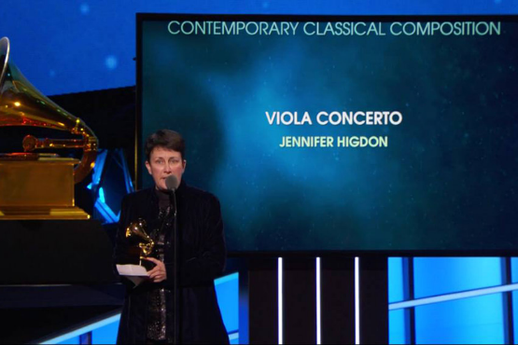
Jennifer Higdon (b. 1962) Jennifer Higdon has won numerous awards for her compositions, many of which were composed on commission.
z

Slide 25
Blending Old and New
Higdon has used everything from knitting needles to drinking glass rims and mallet percussion to create ethereal timbres
She also features virtuosic technic and beautiful, lyrical melodies that captivate her audiences

Slide 26
Summary
At the beginning of the 20th century, women were primarily involved in chamber music
By the end of the century, women had produced an unprecedented amount of both large-scale and experimental works
Women have been engaged in all aspects of 20th century compositional diversity
Who among these women will be known by future generations?

