Slide 1
Segregation and Integration: Instrumental Ensembles from 1900 to the Present
Women, Music, Culture Chapter 12

Slide 2
Chapter Focus
Integration, whether musical or non-musical, is a long process that involves pioneers who possess talent and a capacity to endure discrimination.
This chapter examines this phenomenon using a case-study of the professional orchestral system in Europe and America.
The chapter also addresses the notion of intentional segregation.

Slide 3
News Flash: New York Times, July 24, 1938 Antonia Brico First Woman to Conduct Philharmonic!

Slide 4
Antonia Brico was a pioneer orchestral conductor in the 1930s. Unfortunately, the frontier did not automatically open behind her.

Slide 5
News Flash: The Guardian, London, January 10, 2003 The Vienna Philharmonic has Appointed its First Female Musician… Performance Seen by Millions Around the World.

Slide 6
News Flash: Time Magazine, July 25, 2005 Marin Alsop Breaks New Ground in a World of Male Maestros, but not without a Fight

Slide 7
News Flash: BBC News, January 24, 2020 Eímear Noone Makes History as Oscars' First Female Conductor

Slide 8
Gender Spheres: Defined by Culture
Throughout the world, cultures assign relationships between gender and music.
Music is used to convey cultural values regarding sexuality:
Instruments are connected to gender-specific spirits
Instrumental parts are labeled as body parts : head, neck, throat
There is a perception of power over an instrument as a performer manipulates the object

Slide 9
The assignment of instrumental timbres is also gender-specific, as culturally assigned. In your society, where do these stereotypically fall?
Drums_______
Flute________
Harp________

Slide 10
Physical size, strength, and endurance have been cited as reasons to restrict women’s access to some instruments.
The distortion of the female body in performing on certain instruments (such as brass) has also been cited as a concern.

Slide 11
Perhaps a bigger issue…
Often, instrumental music is connected to rituals associated with power.
Restricting access ensures continued dominance by those who control the instruments and their perceived power.

Slide 12
Case Study: Professional Orchestras
One “hallmark” of success in classical music is the professional orchestra.
Accessing the orchestral “system” has proven difficult for women.

Slide 13
Although many well-educated women were available to perform professionally at the turn of the 20th century, orchestras denied women admittance.

Slide 14
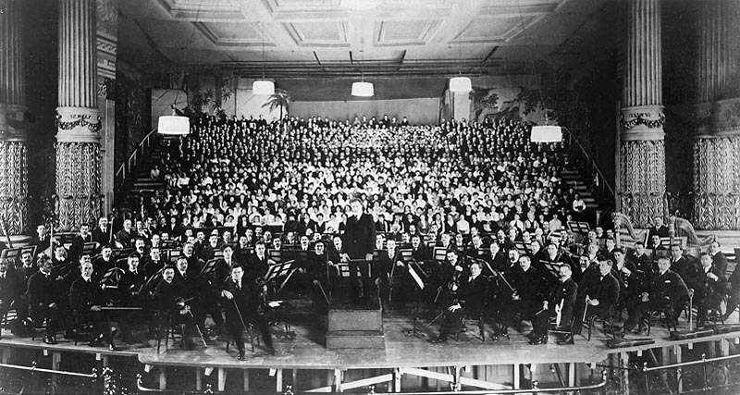
Philadelphia Orchestra conducted by Leopold Stokowski, 1916

Slide 15
“Blind” Auditions
The use of screens in professional orchestral auditions significantly increased the number of women hired by professional orchestras.
After their admittance, many women reported harassment and discrimination within the workplace.
The nebulous nature of assessing musical performance has made sex-bias allegations difficult to prove.

Slide 16
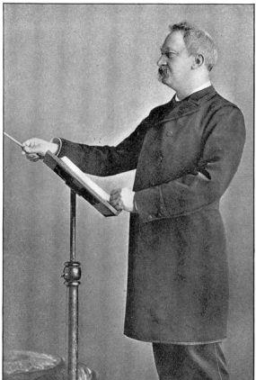
Conductors and Coping Mechanisms
The conductor role has been especially difficult for women to access because it is connected with leadership and control. The image of the male conductor has been deeply engrained into the orchestral system. Prior to 1950, even women on symphony boards were reluctant to hire women as conductors, fearing a negative response from patrons. Shown here is Theodore Thomas of the Chicago Symphony Orchestra.

Slide 17
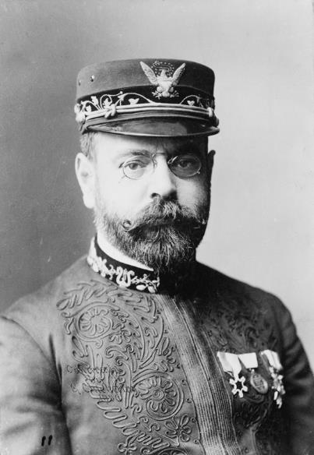
With historical roots in the military, professional bands of the early 20th century continued to be almost exclusively male. Shown here is John Philip Sousa in uniform.

Slide 18
Segregated ensembles were an option for women, but these ensembles often lacked funding, access to good performance venues, and prestige. Women in these groups rarely received pay.

Slide 19
Despite a promising start to her career, Antonia Brico reported that some male performers refused to work with her. She spent the majority of her conducting career working with amateur groups and gender-segregated ensembles.

Slide 20
Ethel Leginska was convinced that to survive “the system,” women had to emulate men in conduct and dress. She abandoned bare-shouldered dresses in favor of masculine attire in an effort to project the “expected” image.

Slide 21
Intentional Segregation
Today, some women participate in all-female ensembles by choice.
Sometimes all-female ensembles intentionally address stereotypes and provide a venue for women’s empowerment.

Slide 22
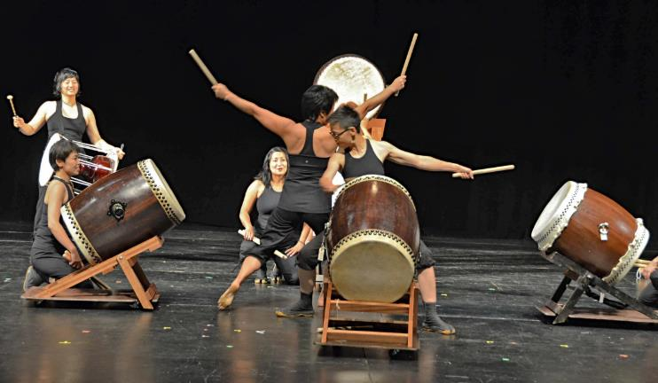
Asian-American Taiko Practice
One segregated form of resistance is found in Asian-American taiko. Ensembles such as Raging Asian Women use taiko to make bold statements about women’s rights, and to build positive self-identity for women.
Photo by Dennis Lui, used by permission

Slide 23
Today’s status
The professional orchestral world remains elusive:
social class, race and gender continue to restrict equal access
along with private study, social connections are important
women remain strongly underrepresented in certain instrumental performance areas, particularly as section leaders and conductors in professional orchestras
Many other instrumental ensembles still exclude women through a “gigging system” that is accessed by informal invitation. This remains the case in jazz ensembles, for example.
Some women continue to utilize all-female ensembles, just as others continue to work on inclusion and status within professional integrated ensembles.

